Slide 1
ECOP Pending Tracking Requirements in Aging & Disability Wednesday, March 12, 2025 2:00pm to 3:00pm
For ASAP Training Purposes Only.

Slide 2
Agenda
Welcome
Overview of ECOP Eligibility
Overview of ECOP Maximum Enrollment Allowance
ECOP Pending Tracking Business Rule
Case Examples
Questions
For ASAP Training Purposes Only.

Slide 3

Enhanced Community Options Program (ECOP)
Provides enhanced service package to consumers who are NF LOC, are assessed to need and also receive increase services above home care basic level of care to live in the community.
PI 25-01: Enhanced Community Options Program
https://documentlibrary.800ageinfo.com/2025/01/enhanced-community-options-program-ecop-program-instruction-25-01.html
ECOP Eligibility Criteria*:
Home Care Program Eligible
Receiving HC Services in which the cost of services provided is at least 2x HC Basic rate (2/1/2025)
Clinically Eligible for nursing facility services (ie. NF LOC) as determined by an in-person assessment performed by an ASAP RN
Determined ineligible for MH Standard, or be eligible for MH Standard but determined ineligible for the Frail Elder Waiver
Regularly review active ECOP enrolled consumers for MassHealth status & ensure care plan cost remains at or above threshold
* Refer to PI 25-01 for full description
For ASAP Training Purposes Only.
Notes:
Be determined ineligible for MassHealth Standard, or be determined eligible for, or already enrolled in, MassHealth Standard but be determined ineligible for the Frail Elder Waiver
Example:
a consumer who is aged 60-64 but not disabled, a consumer who is aged 60-64 but not financially eligible for the waiver
consumer accessing State-Funded MassHealth Standard through the Community-Based Long Term Services and Supports (CB-LTSS) Screening)

Slide 4
ECOP Maximum Enrollment Allowance
Statewide and ASAP-specific maximum enrollment allowances for ECOP implemented on March 1, 2025. The implementation of a maximum enrollment allowance is intended to ensure the long-term stability of the Home Care Program & services for Home Care consumers.
PI 25-03: ECOP Maximum Enrollment Allowance
https://documentlibrary.800ageinfo.com/2025/02/pi-25-03-enhanced-community-options-program-maximum-enrollment-allowance-.html
Required Actions:*
ASAPs cannot exceed the maximum allowance for ECOP. ASAPs must:
Track and monitor ECOP Pending consumers
Not conduct an assessment for ECOP-related clinical eligibility until enrollment into the program is available
Document in A&D consumers who are identified as appearing to meet eligibility for ECOP
Regularly review active ECOP enrolled consumers for MassHealth status and to ensure care plan cost remains at or above threshold
* Refer to PI 25-03 for full description
For ASAP Training Purposes Only.

Slide 5
ECOP Maximum Enrollment Allowance
Required Actions (continued):*
ASAPs that have up to or fewer number of consumers enrolled in ECOP than the ASAP’s maximum enrollment allowance must:
Determine which consumers appearing to meet eligibility for ECOP should be evaluated for ECOP
Account for actual ECOP enrollment vs Maximum Enrollment Allowance
Be able to determine which consumers have been pending for ECOP the longest and enroll them
Assess the consumer for ECOP clinical eligibility & determine if consumer meets all criteria for ECOP eligibility (as described in PI 25-01) when ECOP slot is available
Update consumer A&D record
* Refer to PI 25-03 for full description
For ASAP Training Purposes Only.

Slide 6
ECOP Maximum Enrollment Allowance
Required Actions (continued):*
Additionally, ASAPs must:
Update A&D consumer record of the consumers identifying as appearing to meet eligibility for ECOP as their status changes
Develop internal process for tracking & monitoring consumers as identified as appearing to meet eligibility but are Pending for ECOP
Monthly monitoring (at minimum) for ECOP-related information
Current ECOP Enrollment
ECOP program spending
ECOP Pending - Consumers noted as appearing to meet eligibility for ECOP
Monitor ECOP enrollments based on ASAP-specific maximum enrollment allowance
Regularly ASAPs should be reviewing active ECOP enrolled consumers for MassHealth status and to ensure care plan cost remains at or above threshold
* Refer to PI 25-03 for full description
For ASAP Training Purposes Only.

Slide 7
ECOP Pending Business Rule Overview
ECOP Pending Care Enrollment available in Aging & Disability (A&D)
Utilization of ECOP Pending Care Enrollment:
Tracking consumers appearing to meet ECOP requirements "ECOP Pending"
Reporting & monitoring total # of consumers pending ECOP
Reporting & program health to ensure appropriate program response & data entry
Consumers are entered into ECOP Pending status until an ECOP enrollment slot is available
DO NOT screen consumers for clinical eligibility until an enrollment slot is available
For ASAP Training Purposes Only.

Slide 8

ECOP Pending Business Rule Overview
ASAPs must keep their consumer data accurate & up to date within A&D
AGE reserves the right to review ECOP Pending care enrollments at any time
For ASAP Training Purposes Only.

Slide 9
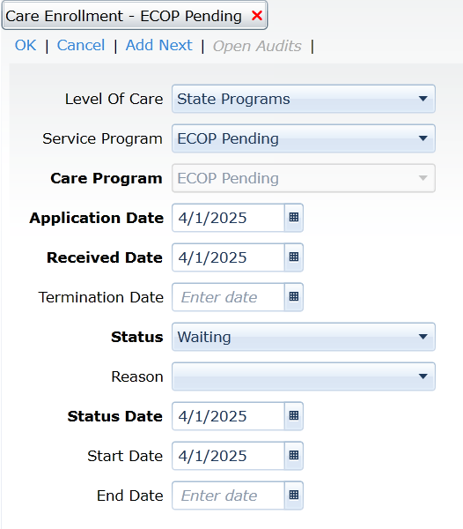
ECOP Pending Tracking A&D Requirements
ECOP Pending Care Enrollment
Utilized to document & track the process & outcome of a consumer who appears eligible for ECOP but has not been clinically determined as there is no available ECOP slot
For ASAP Training Purposes Only.

Slide 10
ECOP Pending Tracking A&D Requirements
ECOP Pending Care Enrollment:
Element | Values | Notes
Care Enrollment | ECOP Pending | Required *Only this care enrollment should be used, do not use other enrollments for this purpose
Status | Waiting Transferred Terminated | Default is Active and must be updated. AGE requires change of status as consumer is pending, assessed, and enrolled in the ECOP / Non-Waiver program or removed from the pending care enrollment list. No other status is acceptable
Status Reasons | Specific Status Reasons should be used for each of the appropriate Care Enrollment Statuses (Chart Below) | Default status reason is Blank. AGE requires change of status and status reason as the applicant engages in and moves through the Home Care Program Intake process.
Status Date | Date Care Enrollment is created
Start Date | Date Care Enrollment is created. Date Consumer is active for ECOP Pending | Start date is always the date AGE is basing the report time frame on. This is used to identify the longest waiting consumer for ECOP pending.
End Date | Date Care Enrollment is closed with appropriate status and reason
Termination Date | Date Care Enrollment is closed with appropriate status and reason
For ASAP Training Purposes Only.

Slide 11
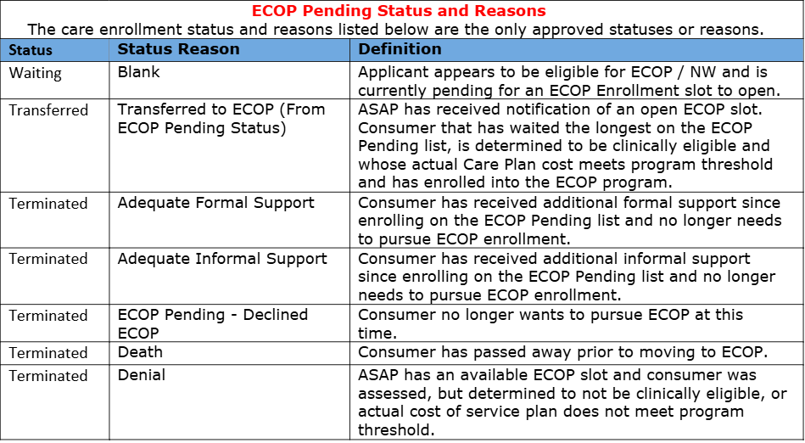
ECOP Pending Care Enrollment Status Reasons
For ASAP Training Purposes Only.

Slide 12
ECOP Pending
Do Not Enroll Consumer into ECOP Pending if:
Currently enrolled in HC Percent Based
Not Eligible for ECOP per PI 25-01, review & discuss FEW
Has MassHealth*
Confirm benefit in EVS, encourage to apply for Frail Elder Waiver
* See PI 25-01 for exceptions
Currently inpatient without a known discharge date
Continue engagement with consumer, make appropriate referrals once discharge date is known
Automatic referral to ECOP when PC need is identified
Need for PC does not automatically initiate ECOP referral. Need for services must be 2x HC POS
For ASAP Training Purposes Only.

Slide 13
ECOP Pending
Case Examples for Supporting Consumers Care Plan Needs While Pending
Example 1: Personal Care is identified as an assessed need
Interdisciplinary Case Conference with RN, to adjust care plan services as needed. RN PC assessment may be required if consumer has not been seen recently by RN for PC assessment
Ex. Decrease HM or Companion hrs to accommodate PC
Example 2: Additional service needs identified during CM assessment
Review care plan
Identify care planning options with consumer & family
Service plan
Service deliveries
Example 3: Consumer expresses n need for additional service(s)
Review care plan and service deliveries & conduct assessment to determine any current status change, identify unmet ADL/IADLs
Determine if adjustments to care plan can be made to incorporate new service need while consumer is Pending for ECOP
For ASAP Training Purposes Only.

Slide 14
Questions?
For ASAP Training Purposes Only.

Slide 15
For ASAP Training Purposes Only.

