Slide 1







Tuesday June 22nd, 2021
3pm-4:30pm
Executive Office of Elder Affairs
RESPECT INDEPENDENCE INCLUSION

Slide 2

Welcome and Attendance!

Slide 3
Home Care Program (HC) Referral & Tracking
Referral & Tracking
What is it?
What will we learn from it?
How do we put this into practice?
Why are we doing it?

Slide 4

Tracking Home Care Referrals: What Is It?
January 2020 - EOEA & Aging Services Access Points (ASAP) network began workshopping to create a system to best understand what happens after an individual is referred to Home Care
Majority of ASAPs already using an A&R (various types)
19 out of 25 ASAPs (76%)
Standardize process across all ASAPs
ASAPs required to
use a consistent method to track referrals made to the Home Care program
as well as the outcomes of these referrals

Slide 5
Intake Tracking in SAMS
Convened a Work Group October 2020
Leveraged ASAP intake tracking information from January 2020
Met Ad Hoc
Home Care Team
ASAPs
Bristol Elder Services
Elder Services of Merrimack Valley/North Shore
Greater Springfield Senior Services, Inc
Highland Valley Elder Services
Montachusett Home Care
Mystic Valley Elder Services
Instituting a “single” A&R to track Intake Referrals to Home Care

Slide 6
Intake Tracking in SAMS
Action Type: HC Program Referral & Intake
Specific Activity & Referral Statuses
Specific Activity & Referral Status Reasons
Next Steps:
HC Program Referral & Intake Business Rule
Implementation this summer
Trainings with Network
New Action, Statuses & Status Reasons available in SAMS 7/1/2021

Slide 7
Intake Tracking in SAMS
A need since SAMS was implemented in 2006
Allows for understanding on an ASAP & network wide scale:
Why consumers & HC Intakes are not opening
Timeframe of how long it is taking to complete HC Intakes
Open the front door to services, close the back door:
How do we get consumers into the HC program & How do we maintain consumers in Home Care?
How can we best serve our consumers?

Slide 8
Putting It Into Practice: SAMS
Activity & Referral: HC Program Referral & Intake
Status Date: Date the referral was formally communicated to the ASAP
Due Date: 5 business days from the referral date
Notes:
Subject and program are optional

Slide 9
Putting It Into Practice: SAMS
Completion Date: Date Initial Assessment completed
If completed, update status to HC Intake Completed Eligible, HC Intake Completed Ineligible, or HC Intake Completed Withdrawn; document Initial Assessment in consumer record; complete Status Reason
If delayed, update status to HC Referral In Progress
If cannot be completed because applicant is not expected to return to community, declines, is unavailable, or ineligible prior to initial assessment, update status to HC Referral Withdrawn(Prior to Initial Assessment)
Notes:
Subject and program are optional

Slide 10
Putting It Into Practice: SAMS
For the HC Referral & Intake Tracking process, a distinction is made between the definition of referral and intake and how it applies to statuses and status reasons.
Referral = no initial assessment has been conducted
Intake= an initial assessment has been conducted
Use of Specific Status Reasons for each Activity & Referral Status
Notes:
Subject and program are optional

Slide 11
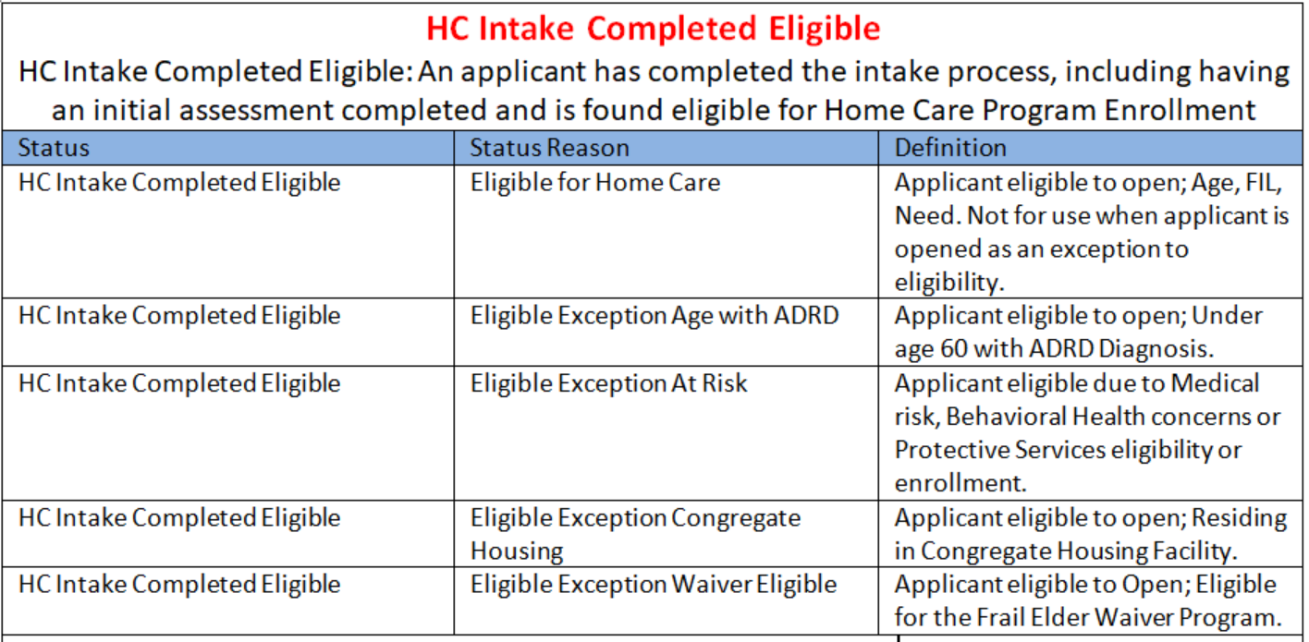
Status Reasons: HC Intake Completed Eligible

Slide 12
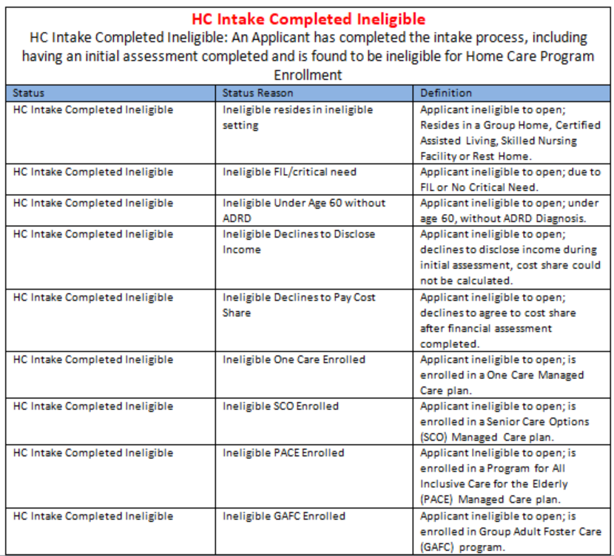
Status Reasons: HC Intake Completed Ineligible

Slide 13
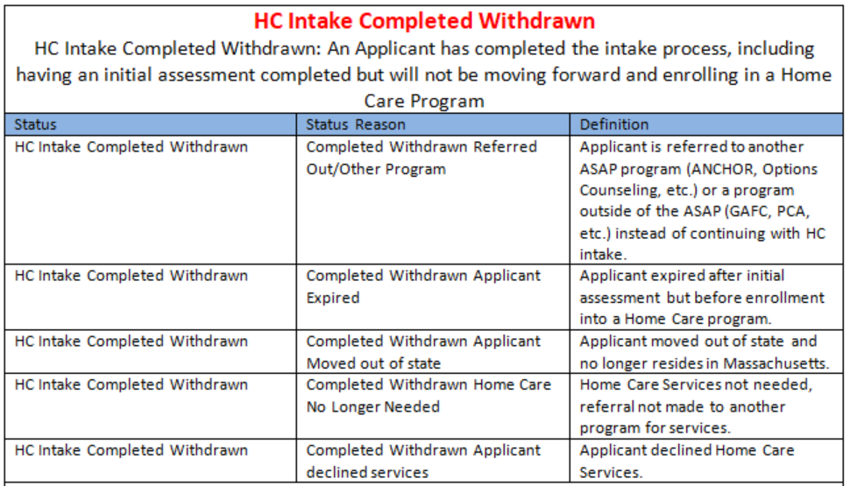
Status Reasons: HC Intake Completed Withdrawn

Slide 14
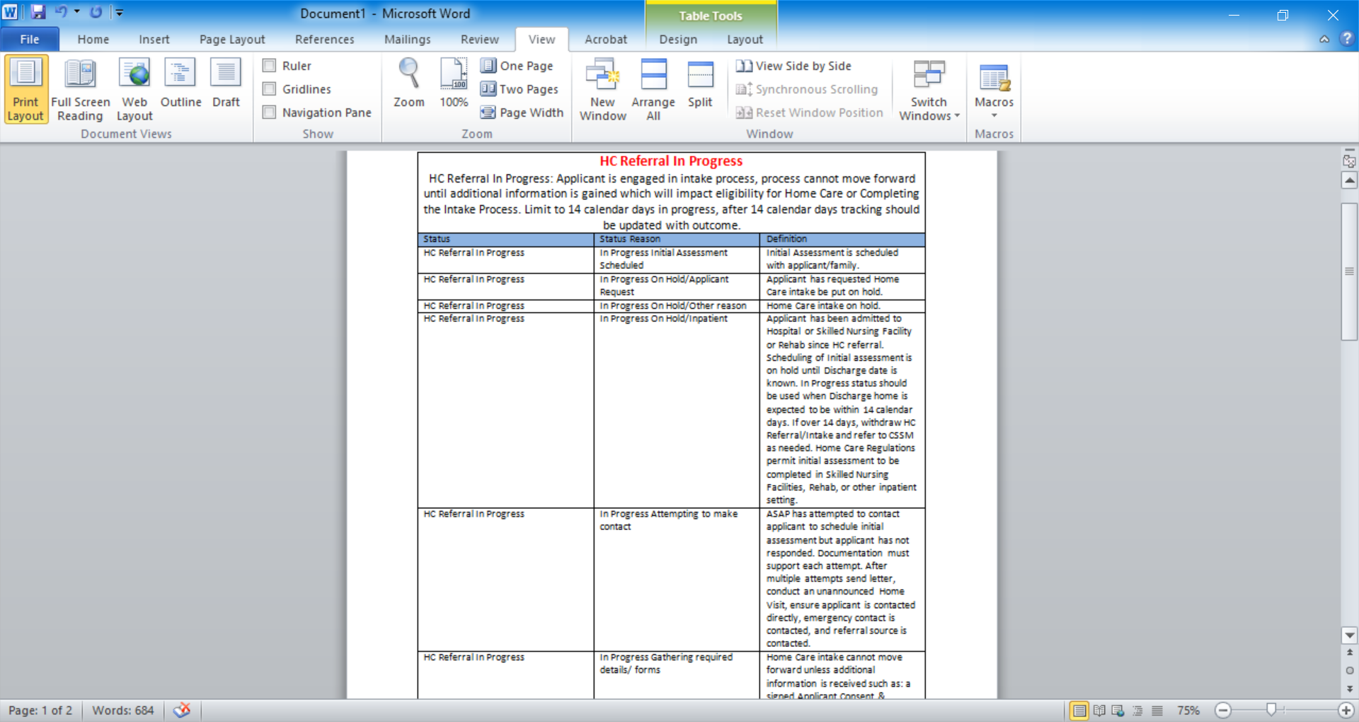
Status Reasons: HC Referral In Progress

Slide 15
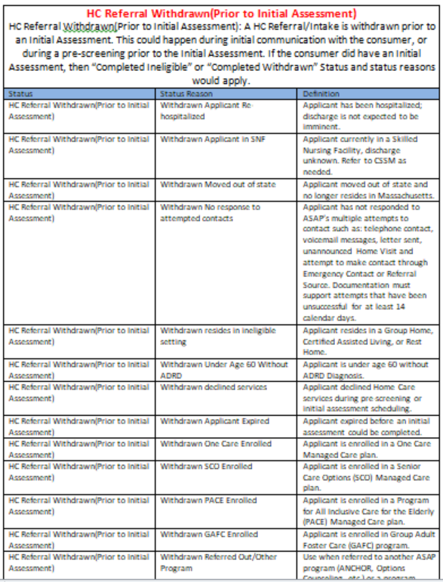
Status Reasons: HC Referral Withdrawn(Prior to Initial Assessment)

Slide 16
Your support and implementation will create a method to better understand your ASAP’s consumer needs, referrals, and goals.
Next Steps:
Begin process of how to implement at your ASAP
Determine effective date to implement
Available in SAMS as of July 1, 2021
Establish process for new intake & completing any existing referrals under previous ASAP intake process
Determine goal for when all referrals should be under new network wide consistent referral & intake tracking
Target September 1, 2021 network wide implementation
THANK YOU for your commitment to strengthening the Home Care program for the residents of the Commonwealth!

Slide 17
For Questions Please Contact:
Devon Garon: Devon.Garon@mass.gov
Brian Glennon: Brian.M.Glennon@mass.gov
Shannon Philbrick: Shannon.Philbrick@mass.gov

