Slide 1


Executive Office of
Elder Affairs
RESPECT INDEPENDENCE INCLUSION

Slide 2
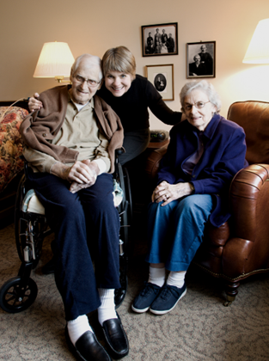
Program Manager/ Nurse Manager Meeting
Home Care Team
January 31, 2019
10 a.m. – 12:30 p.m.
Tri-Valley Inc.

Slide 3

ANCHOR
Advocacy & Navigating Care in the Home with Ongoing Risks
Pilot program that provides highly focused goal oriented care management that provides a more frequent, rigorous and time intensive delivery of advocacy and other support to elders with behavioral health needs who are at risk of institutionalization or homelessness due to their inability to accept or retain services.
ANCHOR Program Overview & ANCHOR Business Rule will be forthcoming
Notes:
Lynn & Devon

Slide 4

ANCHOR
Pilot program designed to support elders or consumers whose behavioral health diagnoses impede or reduce their ability to accept services
Anxiety, suspicion, paranoia
Substance use
Chronic behavioral health concerns
Chronic homelessness or history of housing instability
Family dynamics that impact service delivery
A constant level of risk in their lives that may impact service utilization
Consumer is “pre-protective” or receiving “PS Ongoing Services” and ANCHOR can help transition the consumer to Home Care Services
Notes:
Lynn & Devon

Slide 5

ANCHOR
ECOP Case Management Reimbursement for eligible consumers
Additional $103.48 per month in case management for consumers enrolled in a Home Care program
$241.22 per month Case management rate for consumers who are not yet enrolled in a Home Care Program
Includes consumers enrolled in HCB/NW, HCB/W, Respite/OI, Home Care/OI
ANCHOR Program Overview & ANCHOR Business Rule will be forthcoming
Notes:
Lynn & Devon

Slide 6
ANCHOR
Specific ANCHOR Care Enrollment
ANCHOR Service Delivery required to be entered monthly to support enrollment and reimbursement (two service deliveries available)
ANCHOR Only – Used when a consumer is not enrolled in a Home Care Program
ANCHOR Supplement – Used when a consumer is enrolled in ANCHOR in addition to a Home Care program
6-9 month duration
Monthly Home Visits required
Phone Contact at a minimum of bi-weekly
Activity & Referrals required
Specific ANCHOR Journal types required
ANCHOR Program Overview & ANCHOR Business Rule will be forthcoming
Notes:
Lynn & Devon

