Slide 1

ALR Dynamics Online Incident Reporting System
Welcome to the ALR Dynamics training webinar!
We will be starting in a moment….
Meeting link, phone number, and meeting code:
https://statema.webex.com/join/andy.grigorov
1-866-692-3580 | 647 577 755
The training will be given in presentation mode, that is all participants will be muted except for the trainer.
Please enter any questions or comments in the Webex chat window
ALR User Training Webinars, June 2019

Slide 2
ALR Dynamics Online Incident Reporting System
ALR User Training Webinars, June 2019

Slide 3
Agenda
Introductions
Getting Ready
Extracting data from Quick Base
What’s Different? Quick Base vs. Dynamics
ALR Dynamics - Demonstrations
First login
Basic navigation
New report submission
Communicating with EOEA on IRs
ALR Dynamics - Support
User requests
Computer recommendations
Forgot password?
Technical problems?
“Go Live” and Webinar Info
“Go Live” is 12:01 AM Friday, June 28!

Slide 4
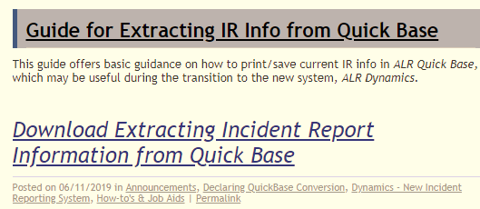
Getting Ready
Extracting Data from Quick Base
Active cases – print/save from QB
All cases – print/save list from report
https://alrir.800ageinfo.com/
See Guide for Extracting IR Info from Quick Base

Slide 5
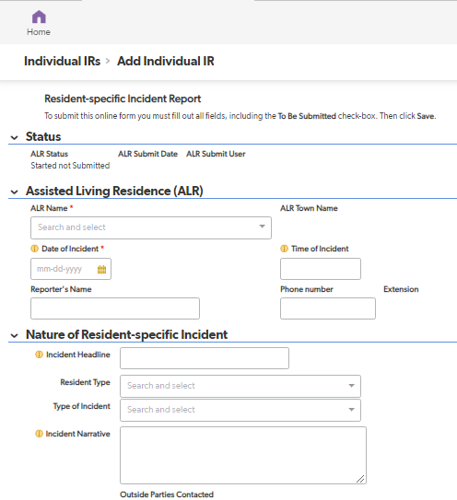
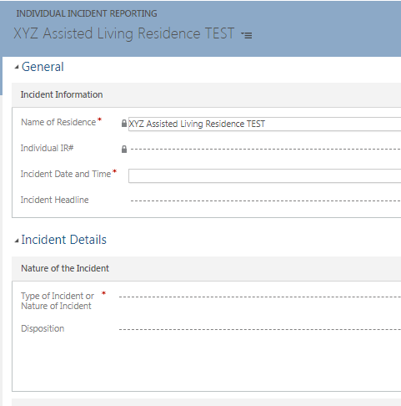
What’s Different? Quick Base vs. Dynamics
Look & Feel
Some item relabeling, questions & drop-downs added to aide user
Resident Identifiers
Name & Date of Birth
Other
Follow up information stays within application (no emailing attachments)

Slide 6
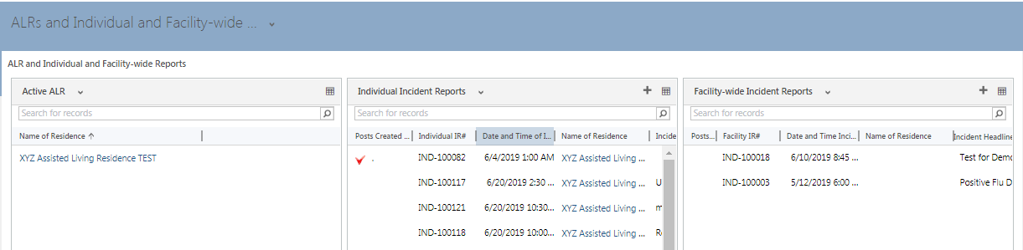
ALR Dynamics Demonstrations
First login
You will receive email with username/temp password/website address
You will need to provide phone and/or email for initial account verification
You will be required to electronically sign Data Access Agreement Basic Navigation
New Report Submission
Communicating with EOEA on IRs
ALR User “Home” Dashboard

Slide 7
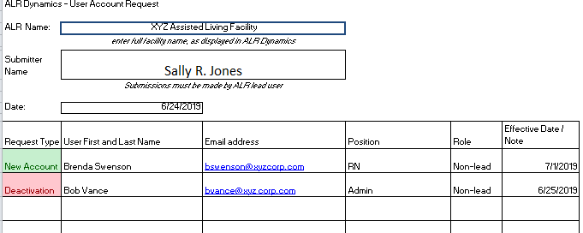
ALR Dynamics Support
User requests
ALR lead user submits all new user requests, deactivations, etc.
Form available on https://alrir.800ageinfo.com/
Submit via email to: alrregs@massmail.state.ma.us
It may take up to 48 hrs for new accounts to be activated

Slide 8
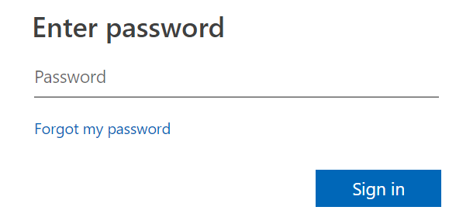
ALR Dynamics Support
Computer recommendations
Desktop browser
Chrome
Firefox
Mobile devices not currently supported
Forgot Password?
You can reset your own password from the login page:
Click on Forgot my password
Follow instructions to have temp password sent to your primary email address

Slide 9
ALR Dynamics Support
Technical problems?
ALR lead users send to: alrregs@massmail.state.ma.us
IMPORTANT! Include this information in your email for support:
Your name
Your ALR name
Detailed description of issue, including:
the internet browser you are using
what occurred
what action was taken before issue occurred
screenshot of any error message received
Current status (are you able to continue work? what if anything is issue preventing you from doing?)
Don’t include and resident PI

Slide 10
ALR Dynamics Support
Available on ALR-IR Support blog (https://alrir.800ageinfo.com/):
ALR Dynamics User Guide v1
This PowerPoint presentation
Paper Form – Incident Reporting if Dynamics is unavailable
ALR User Request Form – in various formats
Guide for Extracting IR Info from Quick Base
Announcements, FAQs and more…

Slide 11
“Go Live” and Webinar Info
All IRs should be submitted using ALR Dynamics as of
12:01 AM Friday June 28.
Use faxed paper form as back up if you miss Friday training.
Training Webinars:
Thursday, June 27, 11 AM – 12:30 PM
Friday, June 28, 1 PM – 2:30 PM
Weekly Check-in Webinars:
Tuesdays 1:30 PM – 2:30 PM starting July 2
CONNECTION INFO FOR ALL WEBINARS:
https://statema.webex.com/join/andy.grigorov
1-866-692-3580 | 647 577 755

