Slide 1
AGD - Streamlining AFC/GAFC Determinations
Pilot Kick-Off & Provider Training
June 17, 2014
Executive Office of Elder Affairs

Slide 2
Agenda
Greetings & Introductions
About AGD
Current/ Future Process
AGD is part of SIMS
SAMS 101
Process Overview
Process Demo
Pilot Timeline & Upcoming
Expectations & Point-person Role
Communications & Support
Q&A

Slide 3
Pilot Participants & Project Team
Pilot Organizations
HEARTH, Inc.
Peabody Resident Services
Greater Lynn Senior Services
Longevity Care
Caregiver Homes
Greater Springfield Senior Services
All Care Home Care GAFC
Beacon AFC
EOEA / OLTSS
Jim Ospenson | SIMS Business Analyst | Project Manager
Andy Grigorov | SIMS Business Analyst | Project Manager
Pam Gardner | GAFC Program Manager | Project Manager
Mary Ellen Coyne | Assistant Clinical Manager
Allison Ananis | AFC Program Coordinator
Danielle McKnight | ADH/Day Hab Program Manager

Slide 4
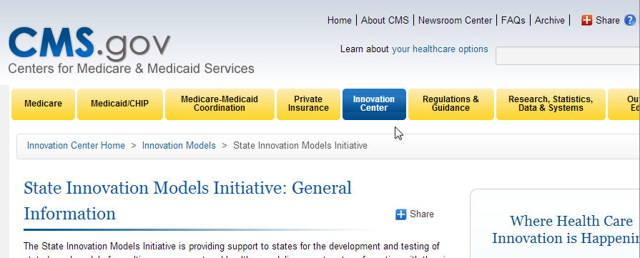
About AGD Streamline
“AGD”?
Stands for AFC & GAFC Determinations
Renamed so that AFC is not buried
Project Objective:
Reduce time-to-determine for all providers
  Last year’s survey showed 20 + days from submission to notification (averaged across all providers)
Project goal: 5 days
AGD is funded by CMMI State Innovation Model Grant
Model Testing Award to Massachusetts EHS in Feb 2013
Other agencies: MassHealth, DPH, DMH, CHIA, GIC, Elder Affairs
AGD is 1 of 4 ELD projects
For more info
    http://innovation.cms.gov/initiatives/state-innovations
    http://www.mass.gov/eohhs/gov/commissions-and-initiatives/state-innovation-model-grant.html

Slide 5
Current-state: 2-tiered system for AFC & GAFC Determinations
Provider orgs: new to SIMS (not ASAPs)
Record clinical information on paper
  Using 7 page MDS-HC “checkerboard” form
Mail application materials to Coastline
  MDS-HC (checkerboard)
  Request for Services
  Physician Summary Form
  AFC Cover Letter
Q&A via phone, replacement materials by snail-mail
Notification by snail-mail
Provider orgs: existing SIMS users (ASAPs)
ASAP locates existing (or creates new) SIMS consumer record
Clinical data:
  applicant’s MDS-HC data is loaded into a
  SIMS CDS-2-RN assessment
Mail additional materials:
  Request for Services, Physician Summary Form, AFC Cover Letter
Q&A within SAMS using Activity/Referral. Updates to MDS-HC, if necessary, within SIMS.
Coastline pulls CDS-2 data into a new CDS-2-RN, adds determination info
Notification by snail-mail

Slide 6
Future-state: AGD process is fully in SIMS... What’s New?
Provider orgs: new to SIMS (not ASAPs)
No more snail-mail
  Consumer’s notification excepted
Login to secure portal
MDS-HC data entered to SIMS
  All data is consistent, only Assessment Narrative is new
Submit digital document scans (RFS, PSF, etc.)
Activity/Referral notifies Coastline of new application
Review determination details in CDS-2-RN (SIMS Assessment)
A completed determination may be viewed the same day notifications are mailed.
Provider orgs: existing SIMS users (ASAPs)
No more snail-mail
  Consumer’s notification excepted
File Attachments for scanned documents (RFS, PSF, etc.)
Use SIMS MDS-HC instead of CDS-2
No default agency-switching
CESI creates Service Order
Workflows guide data entry
The bottom-line:
Not too different!
Everyone will see faster turn-around

Slide 7
What is SIMS?
Information
Exchange
Information
& Referral
SIMS = Senior Information Management System
ELD’s system-of-record for the home care program
(state & waiver), Title III/NAPIS programs, LTC Ombudsman, and Adult Protective Services program
A centralized database & suite of applications with deep business functionality, linking ELD to its operating partners.
  Most SIMS applications are a SaaS (“Software as a Service") solution operated by Harmony Information Systems (www.Harmonyis.com)
  Most users work in Harmony’s SAMS application
  SIMS & SAMS often used interchangeably.
Eligibility
Reporting
Elder Protective
Services
Intake &
Waitlist
Case
Management
Federal Claiming
(CMS)
Care Planning & Service Planning
Provider
Management
Reimbursement,
Billing & Budgeting
Service
Authorization &
Delivery
Fortunately we won’t need to discuss the SIM-grant very often.

Slide 8
Sizing SIMS:
End Users (Mass EOEA, ASAP, AAA)
ASAP, AAA, and EOEA staff I&R, Case Managers, RNs, Fiscal staff | 3,200
Ombudsman (Long Term Care, Community, Assisted Living) | 55
Elder Protective Services Field Staff | 450
Total (Mass EOEA, AAA, ASAP) end users: | 3,665
Consumers | Total
Registered consumers, who have received at least one service since 2004 | 595 K
Lots of Data
Consumers & others | Total
Total individuals in SIMS, since 2004 | 785 K
Including registered consumers, caregivers, and unenrolled I&R callers.
Assessments | Total
Several instruments are used, including the Comprehensive Data Set (CDS) used by Case Managers and RNs for eligibility determination & case management; other assessments include I&R/intake; Nutrition, MFP, and more. | 1.8 M
The CDS is an extension of InterRai’s MDS-HC: the Minimal Data Set for Home Care. Consumers enrolled in EOEA Home Care programs are assessed every 6 months, with a CDS.
End Users (3rd parties)
Direct Service Providers View service authorizations, record electronic invoices | 1,300
Caregivers Community Links Portal - Caregivers (pilot) | ---
Physician office staff, physicians Community Links Portal - Professionals (pilot) | ---
Total (3rd party) end users: | 1,235
Lots of Users

Slide 9
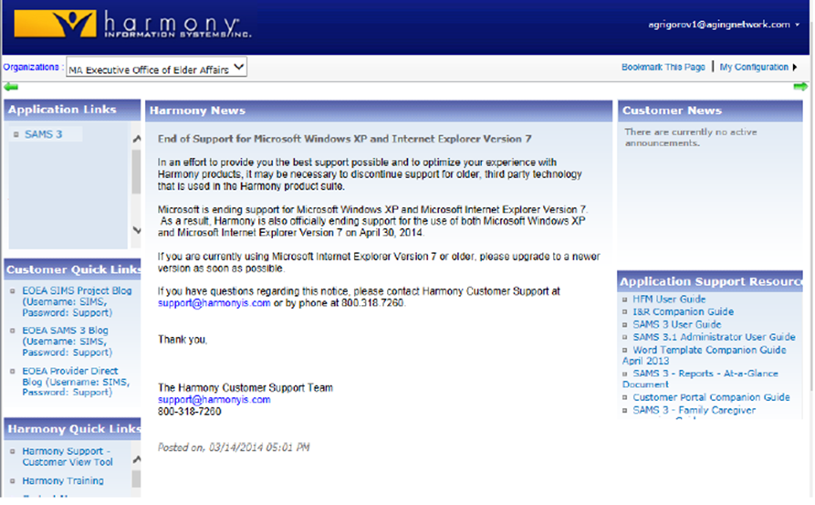
User Account & Portal Page
Harmony Portal: Getting your credentials and first login
  Receive username and temporary password in email
  Answer 3 security questions (in case you forget password)
Click on SAMS 3 Link.
You may be prompted to download “Silverlight”

Slide 10
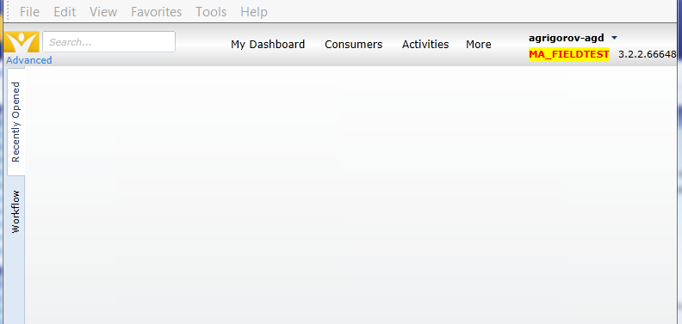
SAMS 101
User Preferences & Navigation
Screen layout | Navigation, searchbox
My Settings | user preferences
Dashboard | Widgets & Saved Searches
Workflow | Triggers & Tasks
Key Data Elements
Consumer record Assessment data & narrative File Attachment Activity & Referral
Other Data Elements
Enrollment Service Order Service Delivery

Slide 11
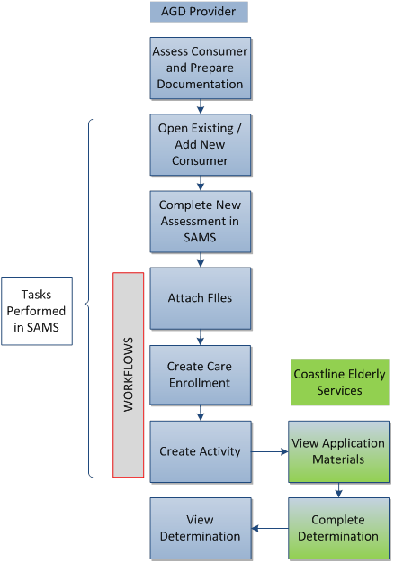
AGD Process
Overview

Slide 12
Process Demonstrations (using SAMS)
Field Test environment using fictional consumers

Slide 13


Pilot Timeline
Date | Item | Note
Fri Jun-13 | User Account Info | Initial set of User Accounts
Tue Jun-17 | Pilot Kickoff | Kickoff meeting for AGD Point-people
Thu Jun-19 | Training Webinar 10am | All end-users. Intro to User Guide. How-to: 1st login, User Account setup, security questions. AGD Process: locate/create consumer, assessment data entry including narrative, file attachments, workflow trigger s & tasks, monitoring in-progress determinations, post-submission of replacement or supplemental clinical documentation per CESI request, notification. Webinar will be available as a recording.
Thu Jun-19 | User Accounts Active | User Account information is emailed to each user after webinar
Thu Jun-19 | Practice Period Begins | All end-users: perform 1st-time User Account setup; one-time workstation setup Practice forgot/reset password (users’ actual accounts in Harmony portal) practice workflow processing in SAMS (field test environment)
Tue Jun-24 | Weekly Webinar (first) | Ongoing Support webinar for any & all users. AGD Point-people (or an alternate) are expected to attend. Project Team will continue weekly webinars as needed. Specific schedule TBD.
Mon Jun-30 | Go-Live | End Practice Period. All User Accounts set to production environment. All determinations via SAMS.

Slide 14
Pilot first, followed by statewide deployment
Like all pilots:
Goal: Smooth out any rough edges
  End-to-end processing with small group before going into wide release
Mission: Identify & correct issues
  … of process, protocol, support, documentation, training, communication, toolset, security, etc.
Method: Iterative
  The 1st release is Project Team’s initial best guess
  The 2nd & subsequent release(s) need your expert end-user input
Expectations for participants:
Expect change
  See Mission & Method.
Speak up!
  … and speak clearly, to help us understand your issue.
  Communications protocols provide structure for efficient communication
  Pass along info, technique, and up-to-date reference material to your organization

Slide 15
Role of AGD Point-person
Primary point-of-contact for all AGD Project & Support communications
Liaison between the AGD Project Team & your organization (end-users & management).
Disseminate information to your organization's end-users. Seek clarification from the Project Team whenever necessary.
Act as the designated voice of your organization. Communicate with AGD Project/ Support Teams via standard protocols.
Identify two (2) point-people for continuity during vacations or at other locations. Train your alternate.
User Account access administration
identify colleagues who should be SAMS users. Communicate required information to AGD Project/Support Team.
Ensure that end-users can self-manage password resets using security questions/answers on file.
Ensure that User Accounts are terminated as needed; other aspects of maintaining your organization's Administrative Security to Protected Health Information.
End-user training
within your organization, ensure that all end-users can function accurately & efficiently, according to up-to-date business rules. Use training materials made available by the AGD Project Team.
Raise issues and identify gaps or improvements in training or other materials. With your help, AGD documentation & materials will be effective, clear and usable.
Point-people are the first line of user support
Help end-users resolve User Account issues; perform basic troubleshooting; and incidental training to enable successful use of SAMS.
If a technical or administrative issue emerges, the Point-person gathers details and communicates, in place of the end-user, directly with support staff at ELD/OLTSS.
Point-person’s function continues after implementation ends
… and operations become routine. Personnel may change after use becomes familiar.

Slide 16
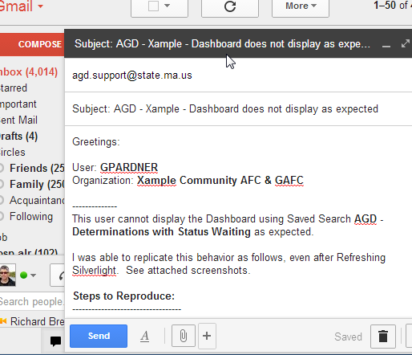
Communication & Support
Coastline:
consumer-specific clinical issues
AGD Support:
Everything else
Application, User Accounts, configuration, workflow, usage, training, system
Email is required
Decentralized project team
Please do not initiate an Issue Report by voice-mail / phone.
Send follow-up email with issue statement, expected system behavior, and/or screenshots
All email
To: AGD.Support@state.ma.us
CC: individuals if desired
Subject: AGD - <your_org> - 5-7 word headline
Specifics: username, etc.

Slide 17
Thanks

