Slide 1
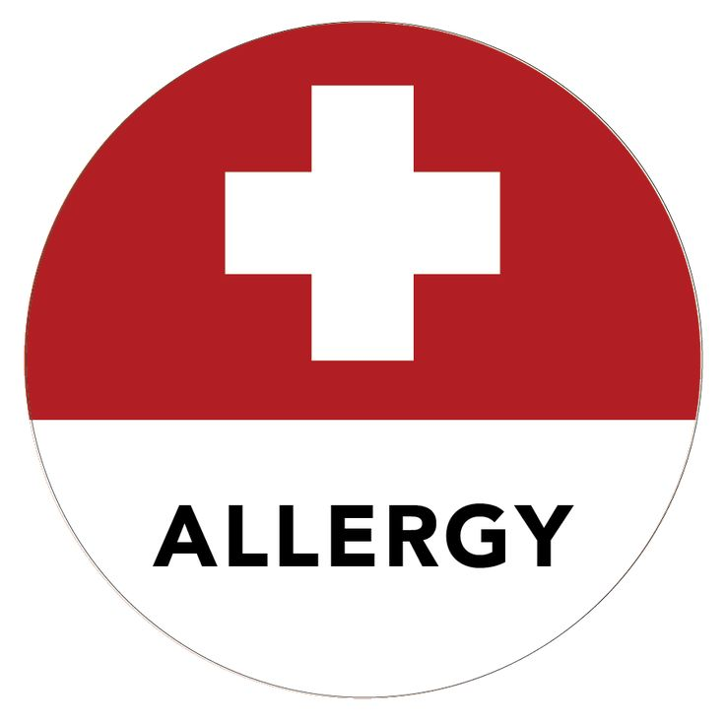
Senior Nutrition Program:
Food Allergy Awareness Training
Presented by:
Notes:
This training is for senior nutrition program meal site managers (Person in Charge), receiving and serving cooked meals from commissary kitchen. This training is required by MA law and must cover certain competence areas to be in compliance. Food Allergen Awareness Guidance | Mass.gov

Slide 2
What would you do?
A couple went to a community dining site for the lunchtime meal. Crab cakes were being served for lunch, but the community dining supervisor assured the couple that there was no shellfish in the crab cake, it was only imitation crab (fish). While eating lunch, the husband’s throat started to close, and he was going into anaphylactic shock. What would you do? How would you handle this scenario?
Notes:
Interactive exercise to get trainees thinking about appropriate allergy response – will revisit at the end of the training to see how their responses have changed.

Slide 3

Learning Objectives
We will learn about:
What are food allergies / intolerances
Major food allergens
Health risks of food allergies
Procedure to follow when a consumer states they have a food allergy
Emergency procedures to follow if consumer has an allergic reaction

Slide 4
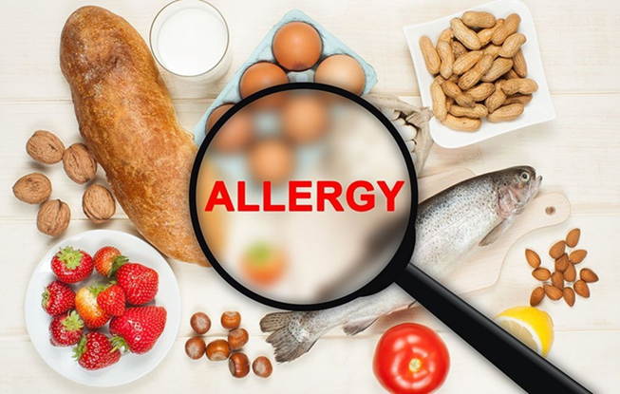
What is a food allergy?
A medical condition in which exposure to a food triggers a harmful immune response
The immune system attacks proteins in the food that are normally harmless
Can be life threatening
11% of adults have food allergies (27 million people)
Every 10 seconds a food allergy reaction sends someone to the emergency room
Notes:
https://www.foodallergy.org/sites/default/files/2024-07/FARE%20Food%20Allergy%20Facts%20and%20Statistics_April2024.pdf

Slide 5

Food allergies in older adults
Increasingly common in older adults
Affects 5-10% of this population
Contributing factors
  Age related changes to the immune system
  Exposure to new foods later in life
https://youtu.be/ClArV2rGoXY?si=gdQ0ccGR91RGFXEz
Notes:
https://pmc.ncbi.nlm.nih.gov/articles/PMC11416488/
YouTube video contains news story about the rising incidence of food allergies in adults and the danger.

Slide 6


What is not a food allergy?
Food Intolerances
  A reaction to food that does not involve the immune system and is not life threatening.
Celiac disease
  Example of a food intolerance. Autoimmune disease that damages the small intestines when gluten is consumed. Gluten is a protein found in wheat, barley, rye, and sometimes oats.
Note it is not your role to determine anyone’s level of allergy or intolerance.

Slide 7
Can you name any of the 9 most common food allergens?

Slide 8
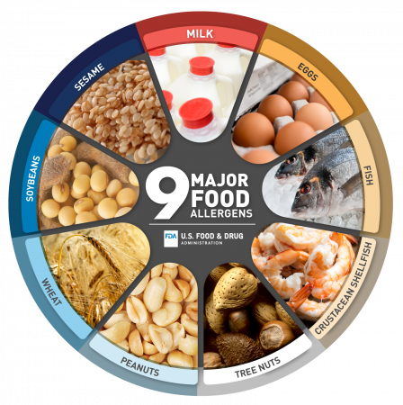
The major (most common) food allergens
Peanuts
Milk products
Soy
Tree nuts
Shellfish
Fish
Egg
Wheat
Sesame
https://youtu.be/o1BuJaSEKW8?si=yZpLmqrwIlZiHcgB
Notes:
Video provides details about foods that may contain allergens – ingredient lists may not always be straight forward (may have “hidden” ingredients).
Milk, specifically cow's milk is a common allergy for babies and young children, but it may also affect adults.
Milk allergy includes all products that are made from milk; cheese, creams, cottage cheese, yogurt, butter. Milk powder can also be added to foods for flavor and texture; things like salad dressings, potato chips, and even bread may contain dairy.
Eggs: One of the most common allergies in America. Baked goods, some salad dressings, meatballs, meatloaf, breaded foods, mayonnaise, eggnog, protein supplements.
Fish: Refers to fish with fins, not shellfish. Fish, some soups, imitation crab, Caesar salad dressing, worcestershire sauce, fish sauce.
Shellfish: Crab, crawfish, prawns, shrimp, lobster
Tree Nuts: Cashews, pecans, almonds, hazelnuts, pistachios, pine nuts, walnuts. Pesto, marzipan, some chocolate spreads, cereal, baked goods, granola bars
Peanuts: Technically considered a legume, peanut is a common ingredient in other foods. Baked goods, ice cream, candy, peanut oil (salad dressings), egg rolls, meat substitutes
Soy: Also a legume, found in soymilk, soy sauce, edamame, tofu, miso, tempeh, some meat substitutes. Commonly used as a "filler ingredient"
Wheat: Breaded foods, wheatgrass juice, soy sauce, processed meats, gravy, cereal, vodka, beer, whiskey,
Sesame: Sesame seeds on or in breads, also used in salads, baked goods, crackers, as garnish, salad dressing, sesame oil, when ground in a paste as Tahini, hummus, sesame flour or sesame salt.

Slide 9
Which of the following are common food allergy symptoms?
2. Hives
3. Abdominal pain and vomiting
4. Feeling fain, confused, or passing out
5. All of the above
1. Itchy mouth or ear
Notes:
All of the above!

Slide 10

Common symptoms of an allergic reaction
Mouth
Itchy mouth or ear canal
Nasal congestion or runny nose
Sneezing
Slight dry cough
Odd taste in mouth
Trouble swallowing
Obstructive swelling of the lips, tongue, and/or throat
Emotional
Sense of impending doom
Change in alertness
Mood change
Cardiovascular
Drop in blood pressure (feeling faint, confused, weak, passing out)
Loss of consciousness
Chest pain
A weak or “thready” pulse
Skin
Hives (reddish, swollen, itchy areas on the skin)
Flushing
Redness of the skin around the eyes
Turning blue
Abdomen
Nausea or vomiting
Diarrhea
Stomach pain
Uterine contractions

Slide 11
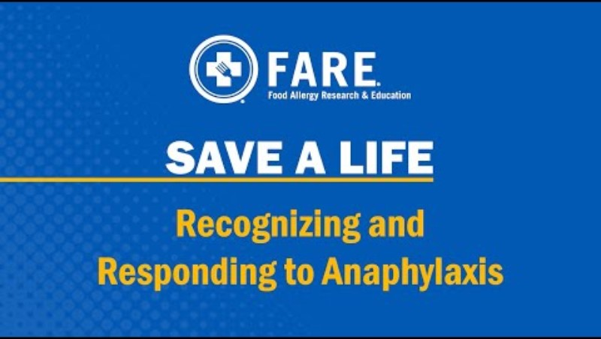
Save A Life: Recognizing & Responding to Anaphylaxis
Watch through 6:17
Please note: this information is being presented for educational and awareness purposes. No one is required to administer epinephrine.
Notes:
Please note: this information is be presented for educational and awareness purposes. No one is required to administer epinephrine.

Slide 12
Anaphylaxis
A severe allergic reaction that is rapid in onset and may cause death!
  It’s not possible to predict if a reaction will be mild or severe
  Severity of reactions and symptoms can vary from one reaction to the next
  A seemingly mild reaction can turn life-threatening in minutes
  Symptoms can vary widely from one person to another

Slide 13
What to do if someone is having an allergic reaction
If you suspect anaphylaxis, ask the consumer or accompanying person if they have epinephrine – immediate treatment is critical! Epi-pens are designed to be self-administered.
Call 911 and tell the operator that it is an anaphylactic reaction (give details of symptoms).
Notify your supervisor.
Do not leave the consumer alone.
Have them lay flat and raise their legs, keep them warm if possible.
If vomiting or breathing is difficult, they can sit up or lay on their side (should not stand).
They should be taken to the emergency room even if they feel better because there is a chance symptoms will return.

Slide 14
Preventing allergic reactions
Post food allergy poster at meal site
Ask new consumers if they have a food allergy at intake
If a client states they have a food allergy, be sure to notify the Nutrition Director / Dietitian to ensure they can be served safely
  Gather more information – what is the allergen and is it life-threatening (e.g., do they carry epinephrine)
  Since food is arriving already prepared, there is no way for you to know all the ingredients that may be contained in the meal (some may be “hidden” and not obvious). Therefore, it is critical to inform your supervisor.
  If it is a truly a life-threatening allergy, it is not safe to serve them the regular meal (ingredients are subject to change and there is a risk of cross-contact).
Notes:
Food allergy poster: https://www.mass.gov/doc/food-allergen-awareness-poster/download

Slide 15
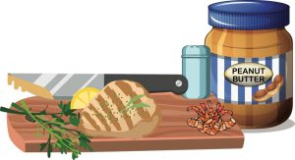
What is cross-contact
  Cross-contact occurs when an allergen is inadvertently transferred from a food containing an allergen to a food that does not contain the allergen.
  Cooking does not reduce or eliminate the chances of a person with a food allergy having a reaction to the food eaten.
  Prevent cross-contact during meal holding, serving, and clean up
Notes:
https://www.foodallergy.org/resources/avoiding-cross-contact

Slide 16

Cross-contact
  Direct cross-contact:
  For example, if croutons are added to a salad, then taken out, direct cross-contact has occurred, and the food allergen remains on the other ingredients.
  Indirect cross-contact:
  A cooking utensil, hands, or a food-preparation surface that has or had the food allergen on it, is then used to prepare a safe food—one that does not contain the allergen. Now the safe food has unsafe food in it.

Slide 17
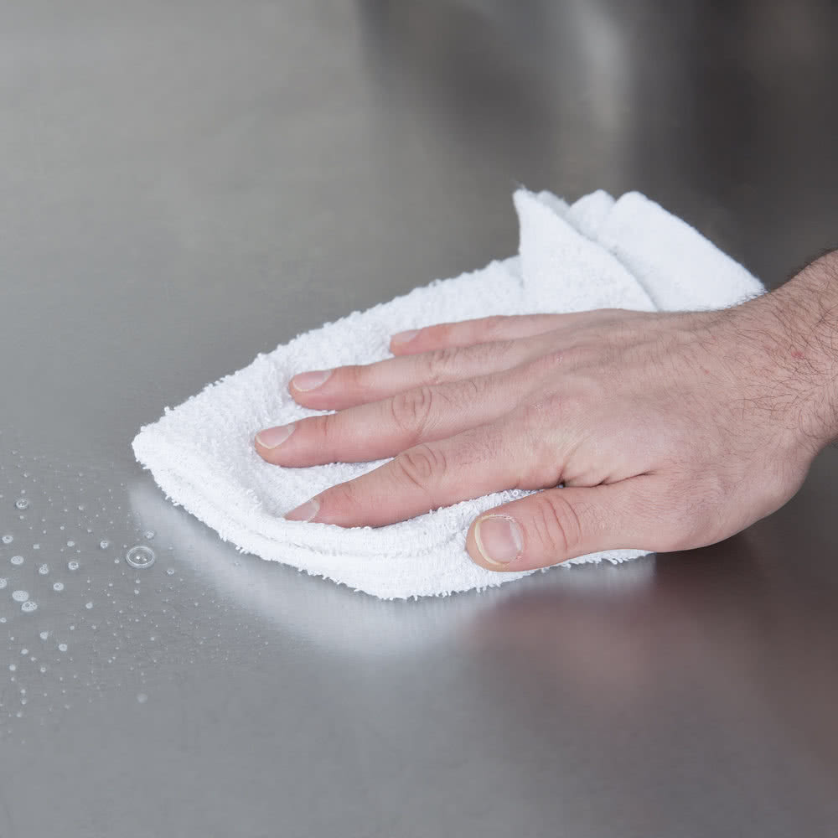
Sources of cross-contact
Hands
Food preparation surfaces
Cooking surfaces
Utensils
Insufficient cleaning

Slide 18

Preventing cross-contact
Wash hands frequently (change gloves).
Use clean utensils and cooking and holding equipment
Maintain separation between food items and use designated serving utensils for each food
Properly clean to remove allergens (surfaces, dishes, serving utensils, cooking and holding equipment)
  Wash with warm, soapy water
  Rinse with clean water & air dry
  Use fresh or disposable cloths and buckets
Sanitizing solutions alone will not remove allergens

Slide 19
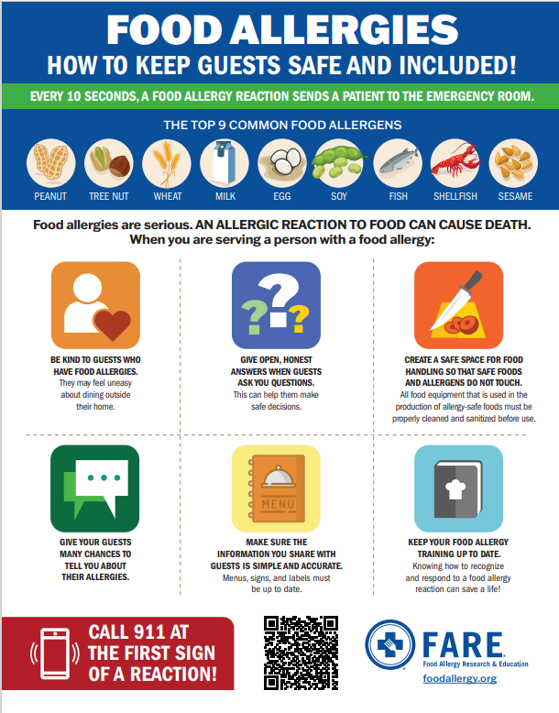
Required poster for meal sites
https://www.mass.gov/doc/food-allergen-awareness-poster/download

Slide 20
In summary
A food allergy is a very serious condition and could be life threatening
If a consumer tells you they have a food allergy, it is important to inform the Nutrition Director or Dietitian to determine if they can be served safely
If someone is having an allergic reaction, you should ask if they have epinephrine and call 911 immediately
Proper cleaning and separation of food items can help prevent cross contact of food allergens

Slide 21
What would you do?
A couple went to a community dining site for the lunchtime meal. Crab cakes were being served for lunch, but the community dining supervisor assured the couple that there was no shellfish in the crab cake, it was only imitation crab (fish). While eating lunch, the husband’s throat started to close, and he was going into anaphylactic shock. What would you have done? How would you handle this scenario?
Notes:
Let’s revisit our case study from earlier – have your answers changed?

Slide 22
Additional Resources
Massachusetts Executive Office of Aging & Independence https://www.mass.gov/info-details/senior-nutrition-program
Massachusetts Department of Public Health Food Protection Program https://www.mass.gov/lists/food-allergen-awareness-guidance
FDA https://www.fda.gov/food/nutrition-food-labeling-and-critical-foods/food-allergies
FARE (Food Allergy Research & Education): https://www.foodallergy.org/our-initiatives/education-programs-training/farecheck

