Slide 1

Nutrition Program Food Safety Training
Presented by:

Slide 2

Learning Objectives
We will learn about:
Keeping food safe for older adults
Common germs found in food
Symptoms of foodborne illness
Maintaining proper temperatures
Kitchen safety
Four basic principles of food safety

Slide 3
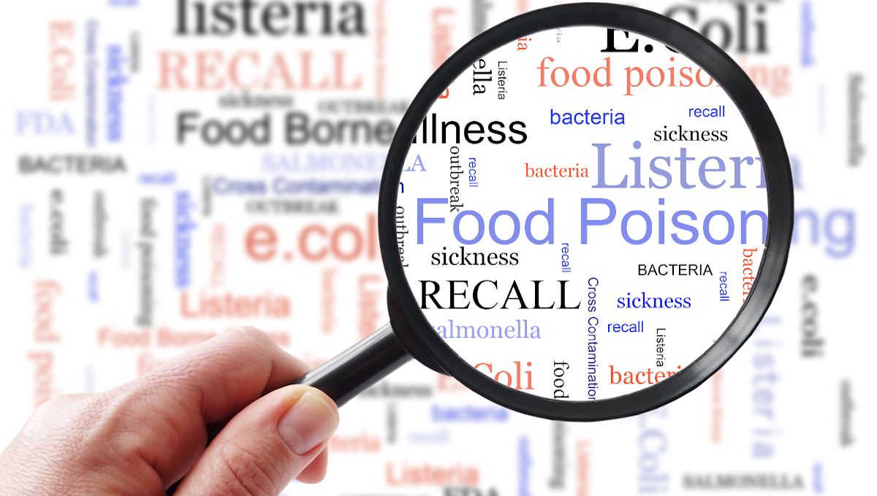
What is Food Safety?
Food safety refers to the conditions and practices that preserve the quality of food to prevent contamination and food-borne illnesses
Caused by microscopic germs including bacteria, viruses, and parasites
There are almost 10 million cases of domestically acquired foodborne illnesses each year, 53,000 hospitalizations, and 931 deaths (CDC)
Consequences are more severe for older adults
https://www.youtube.com/watch?v=-aZhUamumnQ&t=15s
Notes:
Estimates: Burden of Foodborne Illness in the United States | Food Safety | CDC
https://www.cdc.gov/food-safety/php/data-research/foodborne-illness-burden/index.html

Slide 4
Why are Older Adults at
Higher Risk?
The immune response to disease is weaker.
The gastrointestinal tract holds onto food for longer, allowing bacteria to grow.
The liver and kidneys may not properly clear bacteria and toxins.
The stomach produces less acid causing more bacteria to be in the intestinal tract.
Underlying chronic conditions, such as diabetes and malnutrition.
Decreased sense of taste and smell.
https://youtu.be/_nA9vG-p2FY

Slide 5
Common Microorganisms that Cause Food Borne Illness and the Foods they are Found In
Norovirus – any foods can be contaminated by an infected person
Salmonella – chicken, beef, pork, eggs, produce, and processed foods
E. Coli – meats, produce, unpasteurized milk or juice
Hepatitis A – raw shellfish and salads
Campylobacter - unpasteurized milk products and raw or undercooked poultry seafood
Listeria – unpasteurized milk, deli meat, and cheese
Shigella – dairy, poultry, salad mixes (e.g. tuna)
https://www.fda.gov/files/food/published/Most-Common-Foodborne-Illnesses-%28PDF%29.pdf

Slide 6
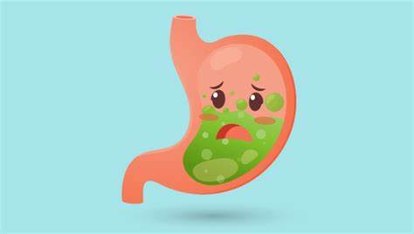
Report Symptoms to Person in Charge
Vomiting
Diarrhea
Sore throat with a fever
Jaundice (yellowing of the skin and eyes)
Sores with pus
Notes:
If you or someone working at the site has these symptoms – report to the Nutrition Director.

Slide 7

MA State Food Code
State law
Incorporates the 2013 FDA Model Retail Food Code and its 2015 supplement
Enforced by local boards of health
Provides food manager certification (ServSafe) exemption for meal site person in charge (PIC) receiving cooked foods.* This training today meets the sanitation requirements.
*If local board of health agent is requesting ServSafe documentation, refer them to the Nutrition Director.
Notes:
105 CMR 590.001 https://www.mass.gov/doc/merged-food-code-111618/download
Food code update is in development.

Slide 8
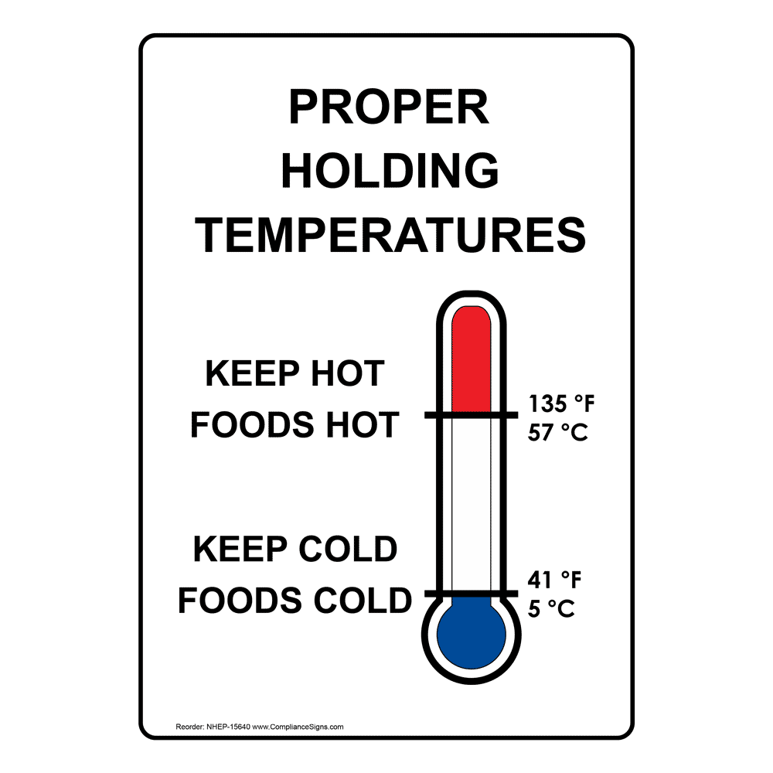
Danger Zone
Bacteria grow very quickly at temperatures between 41°F and 135°F.
Hot held items should be reheated to 165°F for at least 15 seconds.
Potentially hazardous food left in the danger zone for more than 4 hours should be discarded
Notes:
Potentially hazardous foods (contains moisture, protein, slightly acidic) include:
Raw and undercooked foods from animals, including meat, chicken and other poultry, eggs, raw (unpasteurized) milk and products made from it, and seafood.
Raw vegetables, grains, and fruits or products made from them, including leafy greens, sprouts, and flour.

Slide 9
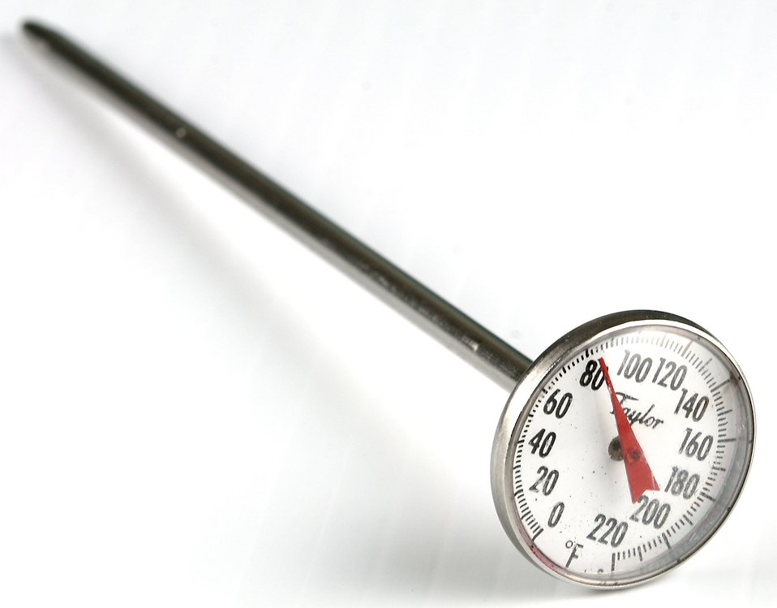
Taking Temperatures
Calibrate thermometer
Wash & rinse
Sanitize with alcohol swab, boiling water, or food safe sanitizing solution
Insert into thickest part of food (or place into food 3-4 pieces thick)
Wait for the temperature to stabilize
Read and document
Wash, rinse, and sanitize again

Slide 10
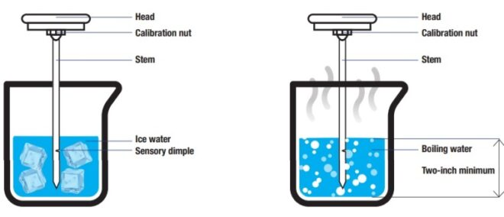
Calibrating Thermometers
Before use, after being dropped, after extreme change in temp.
Use thermometer that can be calibrated (with nut) or digital.
Ice or boiling water method
Wait for the temperature to stabilize
Adjust by gripping nut with wrench or pliers
32°F for ice water
212°F for boiling water
https://www.youtube.com/watch?v=KCjb85pZb6c

Slide 11
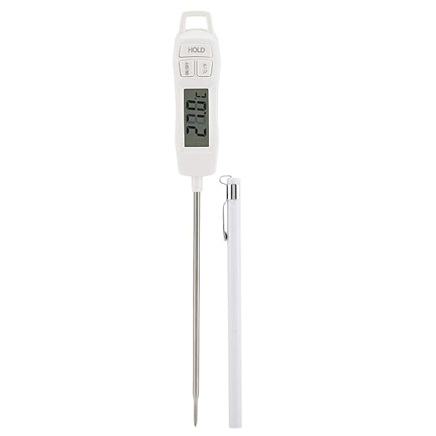
Calibrating Digital Thermometers
Check accuracy using the ice or boiling water method
Follow the manufacturers instructions
Some have a “reset” button which you hold down while in water to see if it shows an accurate reading
The thermometer may need a new battery
Ask your supervisor if you are unsure if the thermometer is calibrated correctly
Notes:
Some programs work with their caterer to regularly provide calibrated thermometers to sites. Infrared surface thermometers are not a replacement for a probe.

Slide 12
Receiving Foods from the Caterer
Immediately check temperature on arrival (keep the thermometer in for at least 30 seconds)
Call the Nutrition Director if it is not at the proper temperature
Check the temperature again at serving time
Hot food should arrive at a minimum of 135°F and held at this temperature
Keep cold foods at 41°F or lower

Slide 13
Holding Food Before Meal Service
Preheat holding equipment
Never use holding equipment such as steam tables to reheat foods
Stir foods frequently
Keep food covered
Never mix freshly prepared foods with foods already being held
Foods in the danger zone more than 4 hours must be discarded

Slide 14
Cleaning Fresh Fruits and Vegetables
Wash thoroughly under water before preparing and/or eating
Using soap, detergent, or commercial produce wash is not recommended
Wash produce even when the skin is not eaten
Use a produce brush to scrub firm produce
Dry produce with a clean towel or paper towel
https://www.youtube.com/watch?v=va2u1m4KoLE
Notes:
Melons and cucumbers are examples of firm produce
Bacteria can be transferred from the surface when peeling or cutting.
Drying further reduces bacteria.

Slide 15

Kitchen Safety
Don’t wear loose clothing or open toed shoes
Keep fire extinguishers and first aid kit nearby
Never leave cooking food unattended
Handle and store knives safely
Be careful of jagged edges when opening cans
Keep floors dry
Keep pot handles turned inward when cooking and never carry pots of hot water
Notes:
Keep anything that can catch fire away from the stovetop

Slide 16
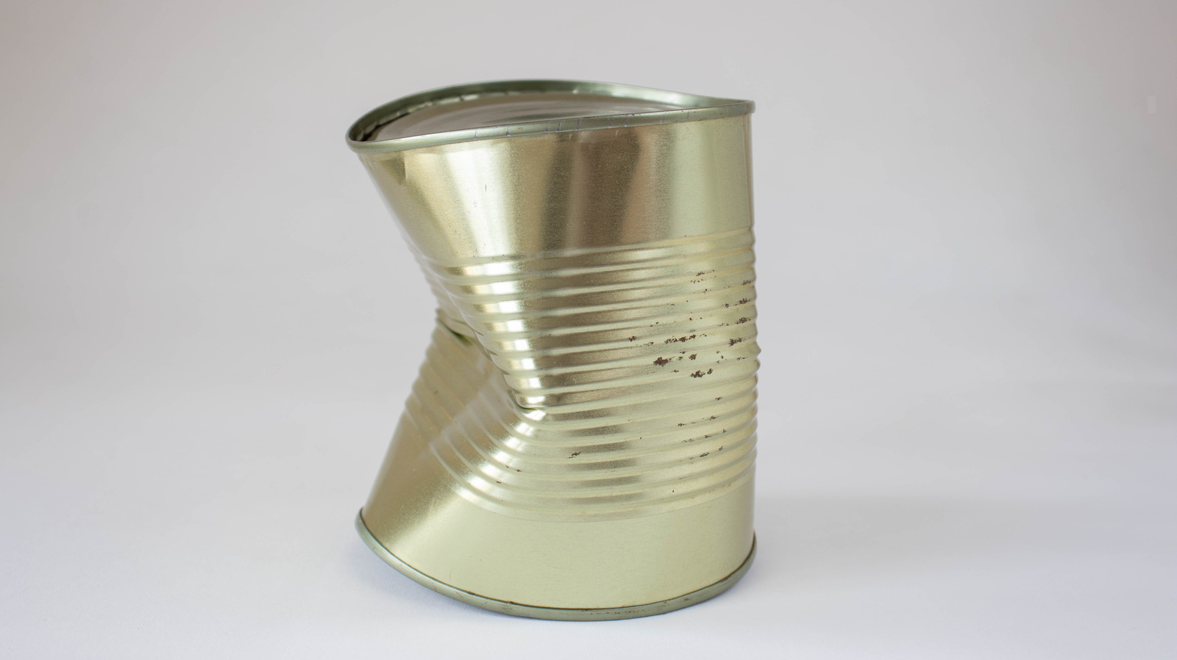
Canned Food Safety
Do not serve home canned food at meal site
Discard heavily rusted cans which can have tiny holes in them, allowing bacteria to enter
If a can has only a small dent on the side(s), the food should be safe to eat. Cans with dents on the seam should be thrown away
Throw away:
  Leaking, bulging, cracked cans or jars or those with loose or bulging lids
  Canned food with a foul odor
  Any container that spurts liquid when you open it
https://www.fsis.usda.gov/food-safety/safe-food-handling-and-preparation/food-safety-basics/shelf-stable-food
Notes:
A sharp dent on the seam can damage the seam and allow bacteria to enter.
Discard deeply dented cans (you can lay your finger into).

Slide 17
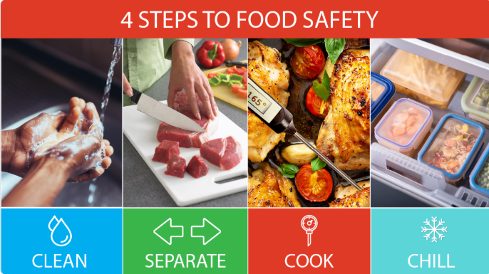
Four Steps to Food Safety
https://www.youtube.com/watch?v=iguM_pqetzo

Slide 18
Step 1: CLEAN
Clean and sanitize before and after preparing food, or different foods, and every 4 hours
Cleaning is the removal of germs, dirt, and impurities from surfaces
It does not always kill germs but reduces their number and the risk of infection
Requires water, soap, and scrubbing
Air drying is best
Use paper towels to clean up kitchen surfaces or launder cloth towels often

Slide 19
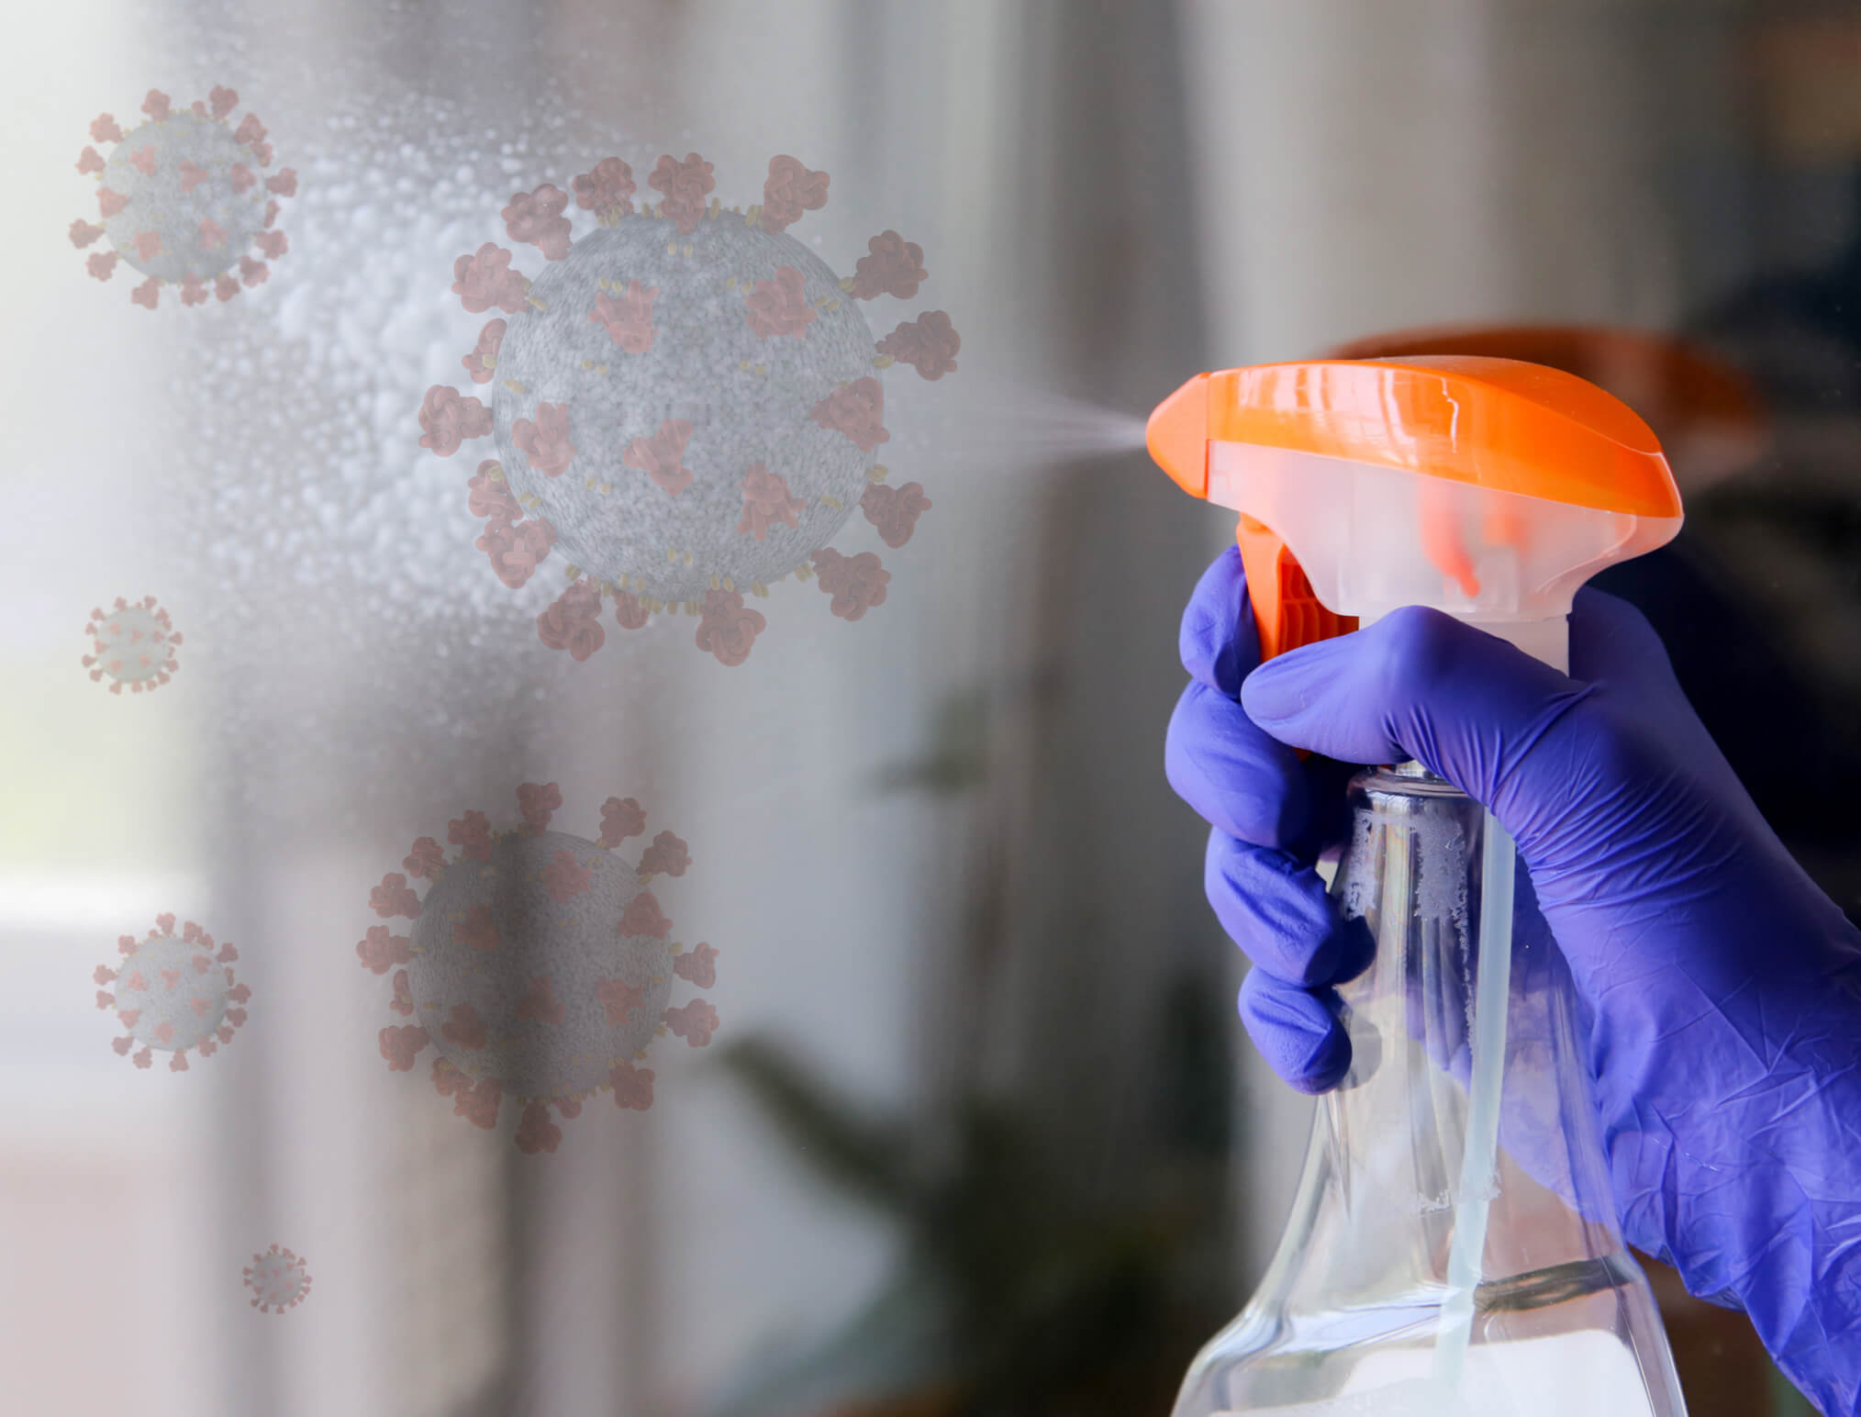
SANITIZE
Sanitizing is the elimination of germs on surfaces or reduction to a safe level
Uses bleach solutions or sanitizing chemicals
Requires cleaning surfaces first!
Prep. solution according to manufacturer’s directions (test with strips)
If solution isn’t available, use 5 tablespoons (1/3 cup) of bleach/gallon of water
Mix fresh solution each day
Cleaning and Disinfecting with Bleach | Water, Sanitation, and Environmentally Related Hygiene (WASH) | CDC
Notes:
https://www.mafoodsafetyeducation.info/sites/default/files/TT_sanitize_eng%20rev%2011-18-21.pdf

Slide 20
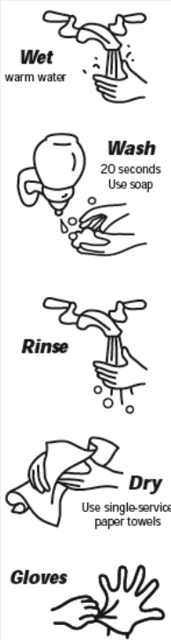
Hand Washing
Wash for at least 20 seconds
Use warm water
Wash your hands after:
  Using the restroom
  Before and after handling raw foods
  Clearing tables or dirty dishes
  Touching hair, face or body
  Touching clothing or aprons
  Sneezing, coughing, or blowing your nose
  Smoking
  Eating or drinking, chewing gum
  Using a phone
  Taking out the trash
  Using cleaning chemicals
  Touching unsanitized equipment
https://www.youtube.com/watch?v=XyvUdQ9u4d8
Notes:
https://www.mafoodsafetyeducation.info/sites/default/files/TT_wash_hands_eng%20rev%2011-18-21.pdf

Slide 21
Step 2: SEPARATE
Prevent “cross-contamination”
Raw meat, poultry, seafood, eggs, and flour should never come into contact with produce or ready-to-eat foods
Use separate cutting boards and utensils when possible
Wash potholders, dish towels, and aprons regularly
Store raw meat and eggs on the lower shelves of the refrigerator
https://www.fda.gov/media/115453/download
https://www.youtube.com/watch?v=PmyljRmNDCc

Slide 22

Step 4: CHILL
Leave space for air to circulate between items in the fridge and freezer
Keep refrigerator and freezer temperature logs
Refrigerators should be set at 40°F or lower and freezers at 0°F or lower
Cooked foods should be cooled from 135°F to 41°F within 6 hours and cooled from 135°F to 70°F within 2 hours

Slide 23
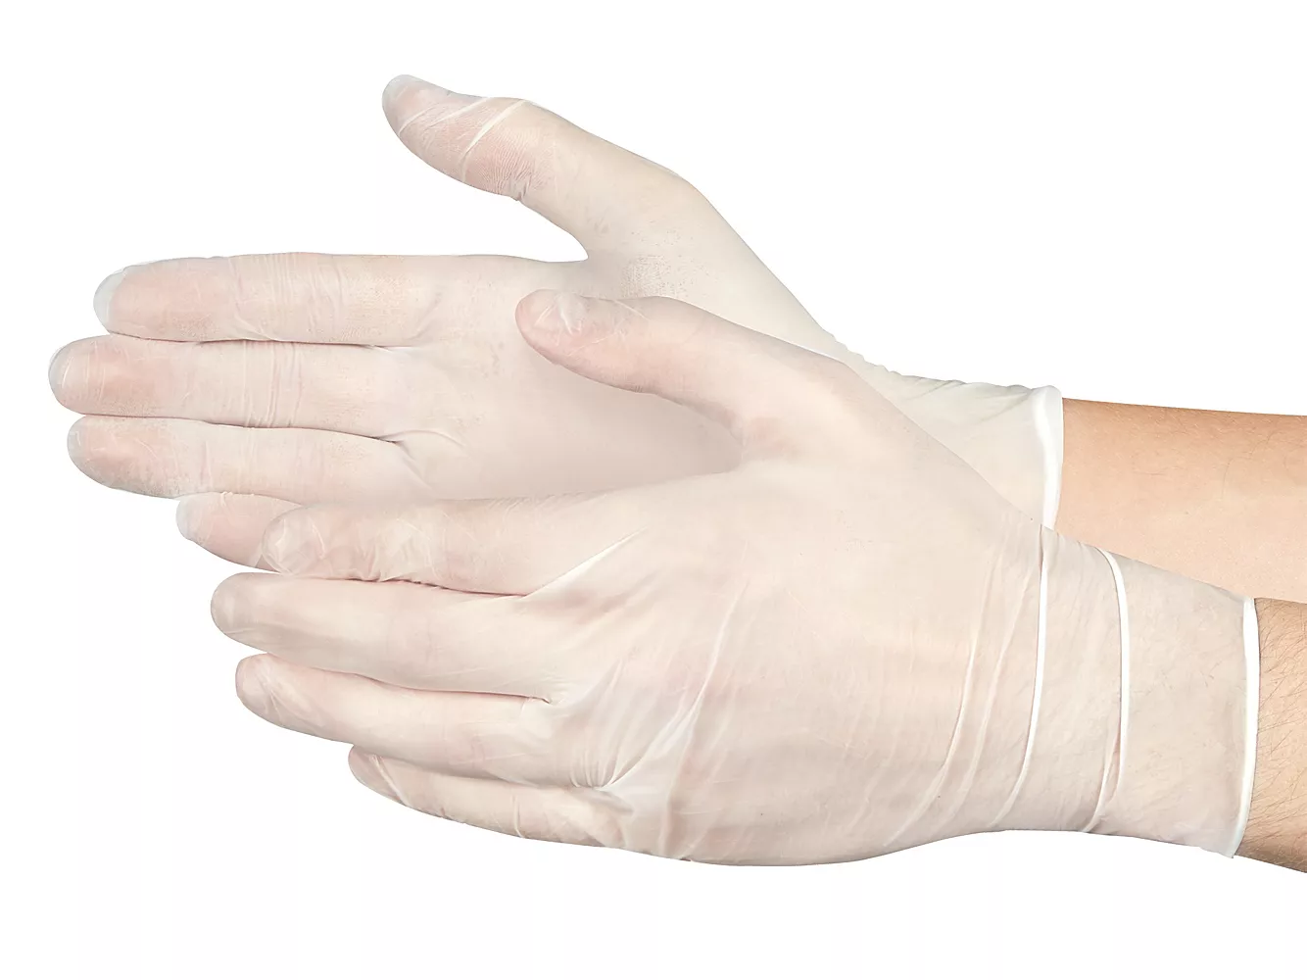
Glove Use
  Always wash hands prior to putting on gloves
  Do not blow in gloves to help put them on
  Change gloves between tasks or after 4 hours of continuous use
  Do NOT reuse or wash your gloves
  Use gloves…
    While serving food
    Doing any food prep or set up

Slide 24
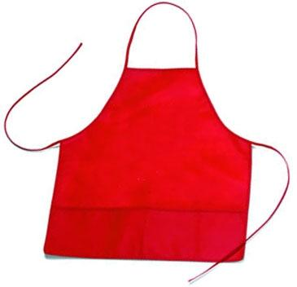
Personal Hygiene Practices
Personal cleanliness
Hair restraints
Clean clothing
Aprons

Slide 25
Program Safety Requirements
Participants may not leave meal site with food (except fresh fruit, wrapped breads, baked desserts, and unopened milk)
Advise participants to refrigerate milk immediately
Meals may not be left for home delivered meal recipients who are not at home
Transport bags and coolers must be cleaned and sanitized regularly

Slide 26

In Summary
Serving safe food, is the most important part of the job
Report symptoms to your supervisor
The four main principals of food safety are: CLEAN, SEPARATE, COOK & CHILL
Make sure foods are at the right temperature
  The DANGER ZONE where microorganisms thrive is 41°F to 135°F
Stay safe in the kitchen to avoid accidents

Slide 27
Additional Resources
Massachusetts Executive Office of Aging & Independence https://www.mass.gov/info-details/senior-nutrition-program
Massachusetts Department of Public Health Food Protection Program https://www.mass.gov/orgs/food-protection-program
Massachusetts Partnership for Food Safety Education https://www.mafoodsafetyeducation.info/
US Food & Drug Administration https://www.fda.gov/food/buy-store-serve-safe-food/safe-food-handling
Centers for Disease Control and prevention https://www.cdc.gov/foodsafety/index.html

Slide 28



Temperatures for Limited Cooking at Site
165°F
Precooked poultry
Precooked beef & pork
Casseroles
145°F
Fish
Starches
Vegetables
Notes:
Meat and meatless casseroles cooked to 165F

