Slide 1



Collecting Sexual Orientation, Gender Identity Data FROM OLDER ADULTS TO IMPROVE SERVICES
Sean Cahill, PhD, Director, Health Policy Research
Bob Linscott, MTS, Assistant Director, LGBT Aging Project

Slide 2
Outline
I. Why collect sexual orientation and gender identity (SO/GI) data in elder service settings?
  A. Understanding LGBT older adults
  B. State LGBT Aging Commission recommendation, recent federal regulatory developments
II. How to collect SO/GI data to improve services
A. Understanding SO/GI terminology
B. The new SO/GI questions
C. How to ask SO/GI Questions
III. How to use the data to improve services for LGBT older adults
IV. Questions, discussion

Slide 3
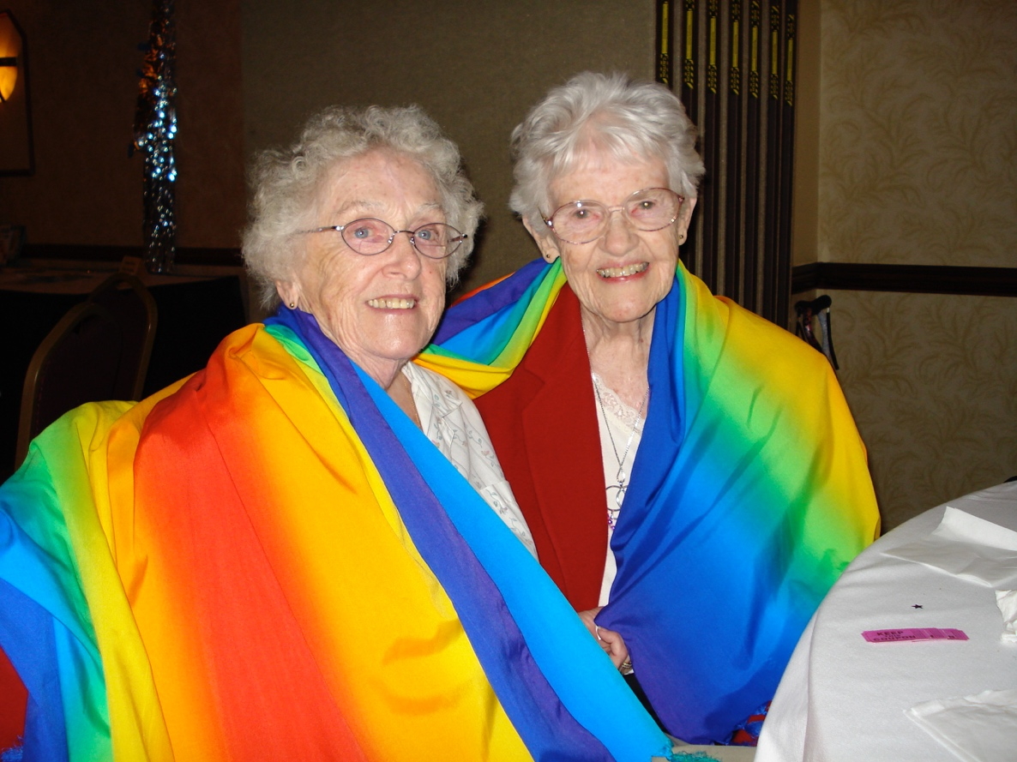
Part I:
Why collect SO/GI Data? Understanding LGBT Older Adults

Slide 4
LGBT people live everywhere
Not only in Boston and Northampton, but in every part of the Commonwealth, including rural areas
LGBT elders come to your senior center, meal program, and live in your nursing home or long-term care facility
It’s important to create a welcoming, affirming environment in which people are comfortable being “out”
Being “closeted” causes minority stress

Slide 5
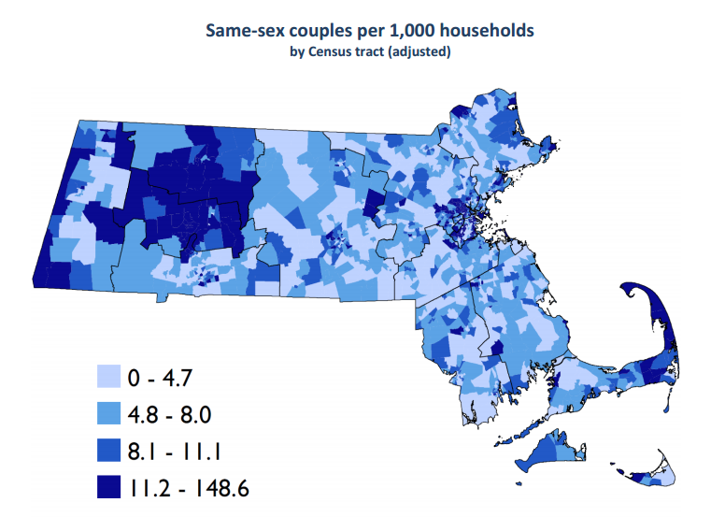
Source: The Williams Institute, UCLA

Slide 7
LGBT Elders
Collecting SO/GI information is important because LGBT elders experience unique disparities and challenges
  May be more likely to be single and/or live alone
  Less likely to have children, grandchildren
  May be more in need of formal caregiving support, elder services than others

Slide 8
LGBT Elders
LGBT elders came of age under conditions of intense homophobia
  Homosexuality criminalized in 50 states
  Categorized as a mental illness; electroshock therapy used as treatment
  Condemned as sin by all major religions
  Legitimate cause for being fired or denied employment
Many LGBT elders thought of non-disclosure as a survival strategy

Slide 9
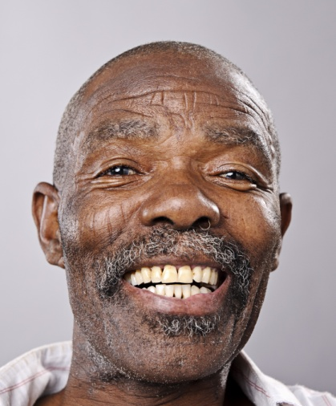
Social isolation may be greater for LGBT elders
Older gay/bi men, bisexual women in Mass. more likely to live alone, according to BRFSS—could indicate social isolation
44% of 2,560 LGBT older adults partnered, 55% live alone (Fredriksen-Golden 2011)
Lower parenting rates for same-sex partners, LGBT elders have implications for caregiving in old age (Gates & Cooke, 2011; de Vries, 2006)

Slide 10
Life experiences shape LGBT elders’ access to health care, support networks
LGBT veterans often associate military service with anti-gay prejudice, dishonorable discharge, may not access Dept. of Veterans Affairs services
For many older gay men, AIDS decimated their social networks, increasing social isolation
Older Americans more likely to hold antigay views, morally disapprove of homosexuality
Ex: 63% of Americans 70+ believe homosexuality “always wrong” vs. 41% of 30-39 year olds
Many older Americans believe wrongly that HIV is casually transmitted

Slide 11
LGBT People and Disability
Research has shown higher rates of disability among LGBT people compared to the general population
  In a sample of 2,560 LGBT adults 50 and older, 47% reported having a physical disability (Fredriksen-Goldsen et al. 2011)
  Aggregate data from 2003 – 2010 WA BRFSS showed that 41% of LGB people age 50+ had a physical disability compared to 35% of heterosexuals

Slide 12
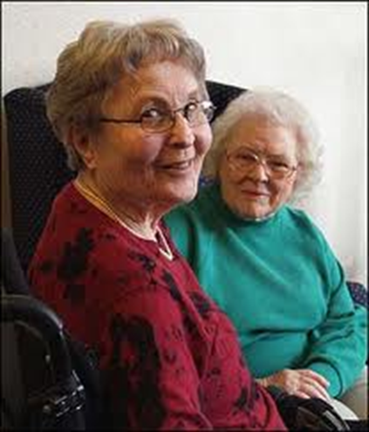
Concerns re: health care
Some LGBT elders fear discrimination in health care and in senior living settings, from home care aides (Stein et al. 2010)

Slide 13
State Commission Recommendation, Recent Federal Regulatory Developments

Slide 14
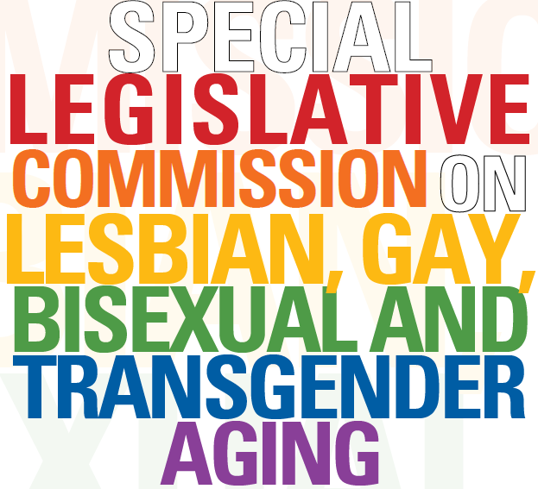

Slide 15
1. Data Collection
Exec. Office of Health & Human Svcs., Exec. Office of Elder Affairs, Dept. of Housing & Community Development should collect voluntary and confidential sexual orientation and gender identity data as a standard practice for:
  Individual assessments
  Program monitoring data systems
  Consumer satisfaction surveys
  Public health surveillance
  Research and evaluation
“If you don’t count us, we don’t count.”
  Massachusetts Special Legislative Commission on LGBT Aging Recommendations, September 2015

Slide 16




Slide 17
Federal Regulatory Developments
Stage 3 Meaningful Use Guidelines
  According to Centers for Medicare and Medicaid Services, Office of Health IT, SO/GI data fields must be incorporated in EHR software certified under the Meaningful Use incentive program
HRSA to require SO/GI data collection by CHCs for May 2016 in Uniform Data System
  “Improving the health of the nation’s underserved…is a priority of the Health Center Program”
  “Sexual orientation & gender identity can play significant role in determining health outcomes”
Notes:
Department of Health and Human Services, Centers for Medicare and Medicaid Services. 42 CFR Parts 412 and 495 [CMS-3310-FC and CMS-3311-FC], RINs 0938-AS26 and 0938-AS58. Medicare and Medicaid Programs; Electronic Health Record Incentive Program—Stage 3 and Modifications to Meaningful Use in 2015 through 2017.Released October 6, 2015. https://s3.amazonaws.com/public-inspection.federalregister.gov/2015-25595.pdf
Health Resources and Services Administration. (February 1, 2016). Proposed Uniform Data System Changes for Calendar Year 2016. (DHHS publication No. PAL 2016-01).
Additional regulatory developments include the CMS Equity Plan for Medicare beneficiaries, published in September 2015, which calls for the standardized collection of SOGI data for Medicare patients. Published CMS Equity Plan priority areas include expanding collection, reporting, and analysis of standardized data (Priority 1). These are part of overall efforts to advance health, equity, and quality of care to minority and other underserved Medicare beneficiaries.
Centers for Medicare and Medicaid Services. Office of Minority Health. (2015). The CMS Equity Plan for Improving Quality in Medicare. Retrieved from https://www.cms.gov/About-CMS/Agency-Information/OMH/OMH_Dwnld-CMS_EquityPlanforMedicare_090615.pdf

Slide 18
Federal Regulatory Developments
Center for Medicare/Medicaid Services Equity Plan
  “Comprehensive patient data, including…sexual orientation, gender identity…are required to plan for quality improvements, and to address changes among the target populations over time.”

Slide 19
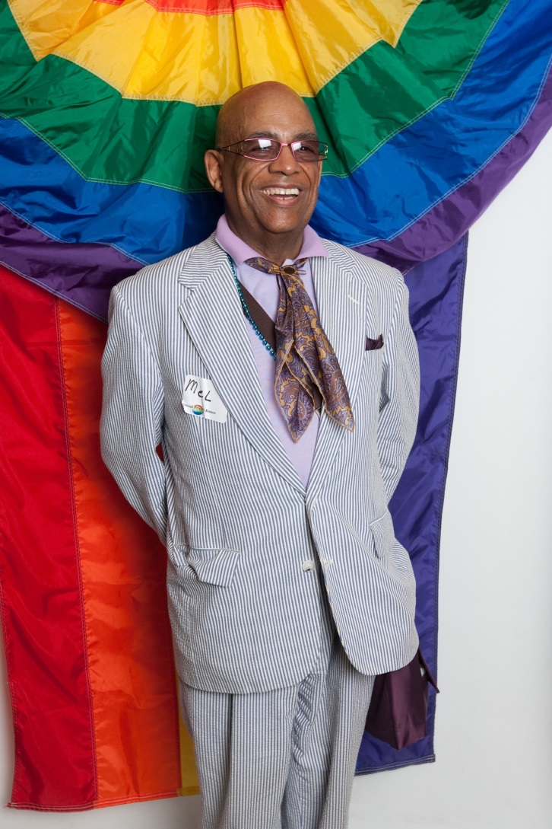
Part ii: so/gi Data collection
Basic SO/GI terminology
The new CDS Questions
How to ask these questions
Framing
Pushback

Slide 20
Recap
  LGBT Elders–
    lifetime of discrimination
    Invisible in aging service demographics
  Current Data Collection–
    Inadequate to meet needs of this population
  EOEA Massachusetts
  working to make entire elder service network safe, welcoming and inclusive for all older adults and caregivers
  Asking demographic questions on SO/GI

Slide 21
Sexual Orientation
Sexual orientation: how a person identifies her/his physical, emotional attraction to others:
  Heterosexual (straight): describes someone who is attracted to people of a different sex
  Gay: someone who is attracted to people of the same sex; gay is usually used to describe men attracted to other men
  Lesbian: describes a woman who is attracted to other women
  Bisexual – individuals who are attracted to both men and women

Slide 22
The ‘Q’ in LGBTQ
  Queer – some may describe their sexual orientation in other ways, such as “queer” instead of LGB
  Questioning – In some cases people just refer to themselves as in a period of questioning the sexual orientation
  It it important to note the the word ‘queer’ is more often used by LGBT youth and for many LGBT older adults the word is often associated with painful memories.

Slide 23
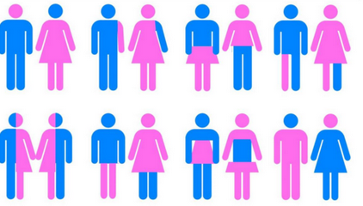
Gender Identity
  A person’s internal sense of gender (do I consider myself male, female, both, neither?)
  All people have a gender identity
Notes:
See the Learning Guide for more definitions and a glossary of terms.

Slide 24
The T in LGBT: Transgender
Transgender
  Gender identity not congruent with the assigned sex at birth
  Alternate terminology
    Transgender woman, trans woman, male to female (MTF)
    Transgender man, trans man, female to male (FTM)
    Trans feminine, Trans masculine
  Non-binary, genderqueer
    Gender identity is increasingly described as being on a spectrum
Notes:
Additional Definitions:
Transgender man – someone who identifies as a man, but was assigned female sex at birth.
Transgender woman – someone who identifies as a woman, but was assigned male sex at birth.
Trans masculine – describes transgender people who were assigned female sex at birth, but identify with masculinity to a greater extent than femininity.
Trans feminine – describes transgender people who were assigned male sex at birth, but identify with femininity to a greater extent than masculinity.
See the Learning Guide for more definitions and a glossary of terms.

Slide 25
Caring for Transgender Older adults
For many transgender people, an important part of affirming gender identity includes hormone therapy and gender affirmation surgeries
Asking someone what pronouns they prefer is very common place today and helps clarify any uncertainty as to the gender the person is expressing
Notes:
Transition is a sensitive term and some consider it to be disrespectful since many transgender people do not think they are changing themselves, only making their appearance consistent with their fully-realized gender identity and sense-of-self.

Slide 26

Sexual Orientation and Gender Identity are Not the Same
All people have a sexual orientation and gender identity
  How people identify can change
  Terminology varies
Gender Identity ≠ Sexual Orientation
Notes:
Sexual orientation and gender identity are distinct concepts. Everybody has a sexual orientation and a gender identity. A transgender person can be LGB or heterosexual. A lesbian, gay or bisexual person can be transgender or not transgender.

Slide 27
Reviewing Terminology
Gender Identity
What your internal sense tells you your gender is
Sexual Orientation
To whom you are physically and emotionally attracted
With whom you have sex
How you identify your sexuality
Sex
Refers to the presence of specific anatomy. Also may be referred to as “Assigned Sex at Birth”
Gender Expression
How you present your gender to society through clothing, mannerisms, etc.
27
Notes:
27
See the Learning Guide for more definitions and a glossary of terms.

Slide 28
Quiz: Which of the following is NOT a sexual orientation?
Heterosexual
Homosexual
Transsexual
Lesbian

Slide 29
Quiz: Which of the following is NOT a sexual orientation?
Heterosexual
Homosexual
Transsexual
Lesbian

Slide 30
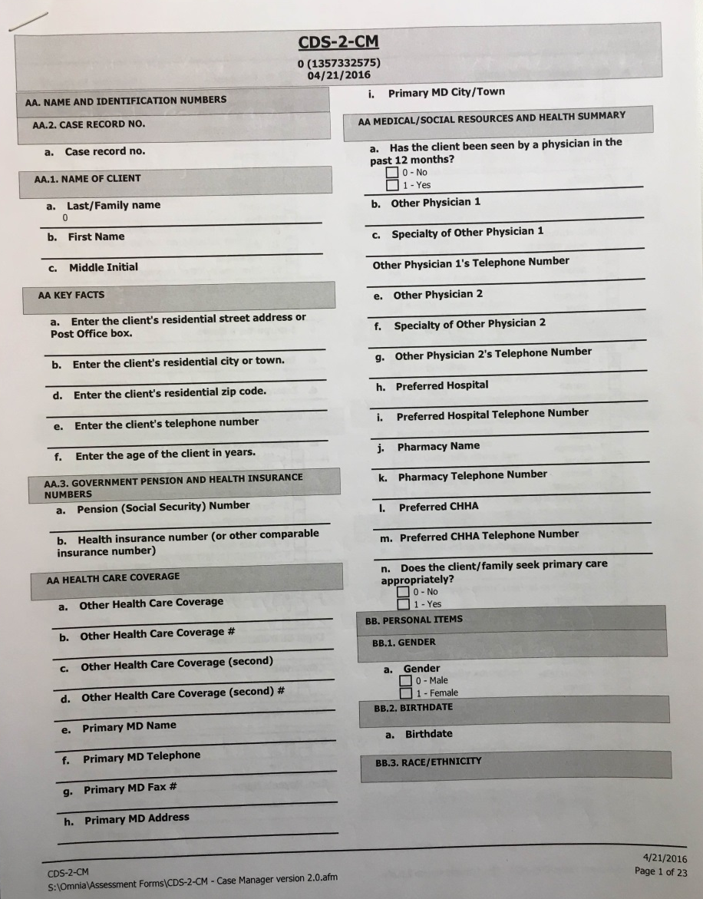

The New SO/GI Questions

Slide 31
CDS 2.3 Section BB. PERSONAL ITEMS Section 1: Gender
The current question 1.a. will be edited.
Gender: What was your sex at birth (on your original birth certificate)?
  Male
  Female

Slide 32
CDS 2.3 Section BB. Personal Items section 1: Gender
New question 1.b. will be added.
What is your current gender identity? (Check all that apply.)
 Male
 Female
 Female-to-male (FTM)/transgender male/trans man
 Male-to-female (MTF)/transgender female/trans woman
 Genderqueer, neither exclusively male nor female
 Additional gender category (or other)
 Did Not Answer

Slide 33
CDS 2.3 Section BB. Personal Items section 2: sexual orientation
New question 2.a. will be added.
Do you think of yourself as:
 Heterosexual or Straight
 Lesbian, Gay or Homosexual
 Bisexual
 Not Sure
 Did Not Answer
 Other

Slide 34
How to Ask SO/GI Questions
Framing the intake interview
  “This is a standardized assessment”
  “It is comprehensive so we can learn as much about each client to provide best possible care”
  “I ask every question to everybody and don’t make any assumptions”
  “I will ask questions that don’t apply to you and questions that are difficult to answer (and for me to ask!)”
  “You can decline to answer anything”
Notes:
Additional Definitions:
Transgender man – someone who identifies as a man, but was assigned female sex at birth.
Transgender woman – someone who identifies as a woman, but was assigned male sex at birth.
Trans masculine – describes transgender people who were assigned female sex at birth, but identify with masculinity to a greater extent than femininity.
Trans feminine – describes transgender people who were assigned male sex at birth, but identify with femininity to a greater extent than masculinity.
See the Learning Guide for more definitions and a glossary of terms.

Slide 35
How to Ask SO/GI Questions
Challenges for Case Managers
  Uncomfortable asking hard questions (race, education, incontinence, $)
  You are experts in asking difficult questions in a compassionate way
  You will develop your style with practice
  Responses
  “We can move on and come back to these questions a little later”
Notes:
Additional Definitions:
Transgender man – someone who identifies as a man, but was assigned female sex at birth.
Transgender woman – someone who identifies as a woman, but was assigned male sex at birth.
Trans masculine – describes transgender people who were assigned female sex at birth, but identify with masculinity to a greater extent than femininity.
Trans feminine – describes transgender people who were assigned male sex at birth, but identify with femininity to a greater extent than masculinity.
See the Learning Guide for more definitions and a glossary of terms.

Slide 36
How to Ask SO/GI Questions
Challenges for non LGBT Clients
  I don’t understand why this is relevant. I just want laundry service.
  Responses
  “Some questions are very important to different people and some questions don’t apply to everybody”
  Remember you can choose to not answer anything.
Notes:
Additional Definitions:
Transgender man – someone who identifies as a man, but was assigned female sex at birth.
Transgender woman – someone who identifies as a woman, but was assigned male sex at birth.
Trans masculine – describes transgender people who were assigned female sex at birth, but identify with masculinity to a greater extent than femininity.
Trans feminine – describes transgender people who were assigned male sex at birth, but identify with femininity to a greater extent than masculinity.
See the Learning Guide for more definitions and a glossary of terms.

Slide 37
How to Ask SO/GI Questions
Challenges for LGBT Clients
  Tremendous fear could arise based on lifetime of discrimination.
  Responses
  “If you are uncomfortable having this on your record, we can keep this between us.”
  Don’t make assumptions based on mannerisms or certain phrases ‘ I live with a longtime friend’ but you can ask –”is this friend important to you?”
Notes:
Additional Definitions:
Transgender man – someone who identifies as a man, but was assigned female sex at birth.
Transgender woman – someone who identifies as a woman, but was assigned male sex at birth.
Trans masculine – describes transgender people who were assigned female sex at birth, but identify with masculinity to a greater extent than femininity.
Trans feminine – describes transgender people who were assigned male sex at birth, but identify with femininity to a greater extent than masculinity.
See the Learning Guide for more definitions and a glossary of terms.

Slide 38
How to Ask SO/GI Questions
About Confidentiality
  Answering SO/GI information is then available to all ASAPs.
  Options
  Make sure they are aware of this if they seem uncomfortable with disclosure
  SO/GI status could be in client notes or kept confidential with Case Manager
  Remind them that having this as part of their care plan improves competent service.
Notes:
Additional Definitions:
Transgender man – someone who identifies as a man, but was assigned female sex at birth.
Transgender woman – someone who identifies as a woman, but was assigned male sex at birth.
Trans masculine – describes transgender people who were assigned female sex at birth, but identify with masculinity to a greater extent than femininity.
Trans feminine – describes transgender people who were assigned male sex at birth, but identify with femininity to a greater extent than masculinity.
See the Learning Guide for more definitions and a glossary of terms.

Slide 39
How to Ask SO/GI Questions
Opportunities for LGBT Clients
  So many LGBT older adults have spent they lifetime invisible and yearn to have this question asked.
  Asking SO/GI validates them and shows that the agency is willing to include LGBT people
  Asking SO/GI creates a safe space that allows LGBT older adults to finally be their authentic selves. That can lead to positive mental/physical health outcomes
Notes:
Additional Definitions:
Transgender man – someone who identifies as a man, but was assigned female sex at birth.
Transgender woman – someone who identifies as a woman, but was assigned male sex at birth.
Trans masculine – describes transgender people who were assigned female sex at birth, but identify with masculinity to a greater extent than femininity.
Trans feminine – describes transgender people who were assigned male sex at birth, but identify with femininity to a greater extent than masculinity.
See the Learning Guide for more definitions and a glossary of terms.

Slide 40
Quiz: Which of the following is NOT an Appropriate term for a transgender person?
Gender Queer
Transsexual
Transvestite
Trans Man / Trans Woman

Slide 41
Quiz: Which of the following is NOT an Appropriate term for a transgender person?
Gender Queer
Transsexual
Transvestite
Trans Man / Trans Woman

Slide 42
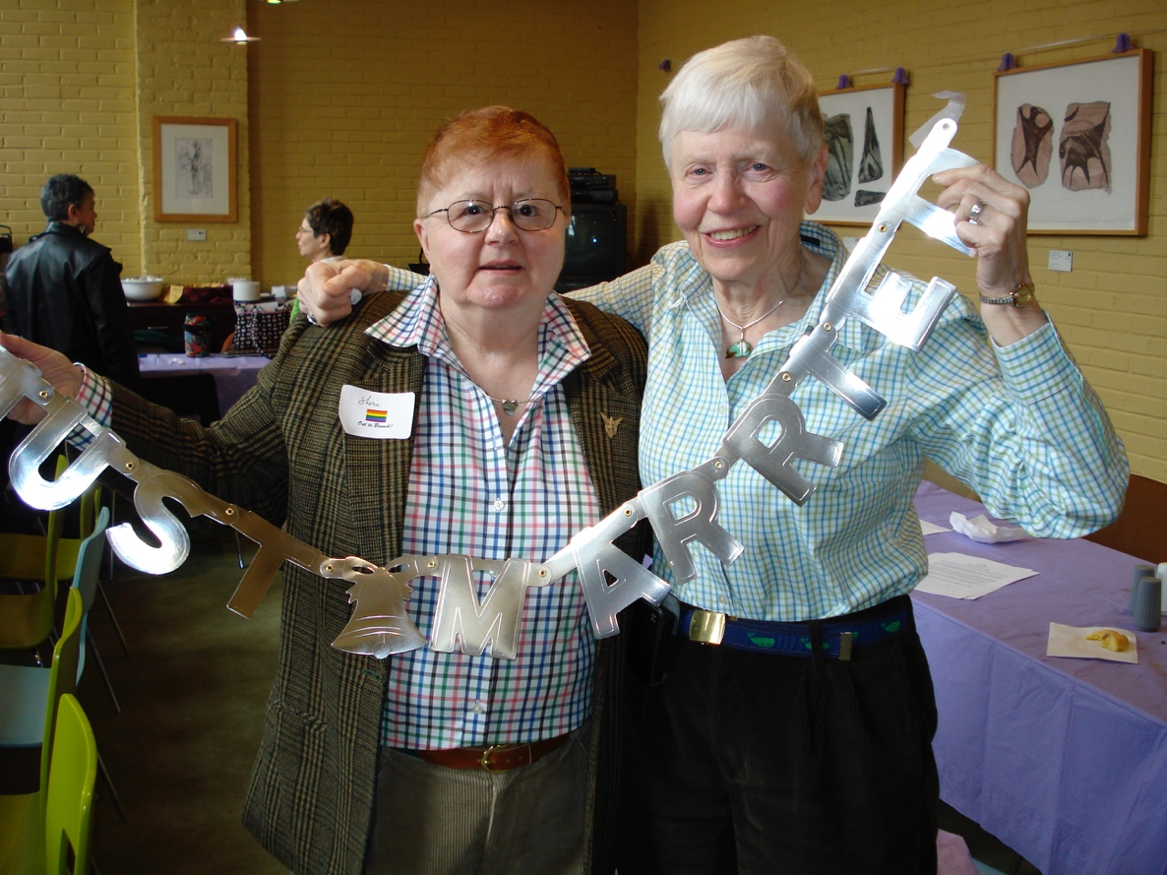
Part III:
How SO/GI Data will improver services for LGBT Older Adults

Slide 43
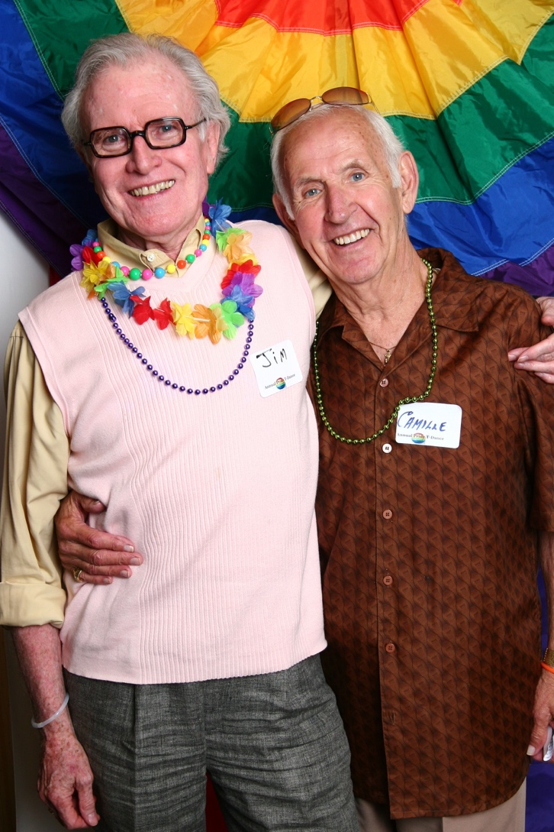
Person Centered Care:
The more that providers know about their individual clients the better services they will be able to provide for them.
Asking for SO/GI data helps address health/home care disparities for LGBT older adults

Slide 44
SO/GI Data will help Improve Services:
Stories from the field
Somerville Cambridge Elder Services
South Shore Elder Services
Senior Care
Ethos

Slide 45
SO/GI Data will help Providers:
Anticipate critical gaps in caregiving for unbefriended LGBT older adults
Address social isolation through programming or referrals to LGBT programs
Identify LGBT clients facing economic hardships
Monitor bullying in senior housing towards LGBT residents

Slide 46
SO/GI Data will help Providers:
Build skills in cultural competency to provide safe, competent services for vulnerable populations – such as home care aides for a transgender elder.
Enable I&R staff to provide specific resources for new LGBT clients

Slide 48
SO/GI Data will help Providers:
Identify the needs of LGBT older adults in their area.
Develop programming to meet those needs.
Help inform an ASAP’s need for additional resources and cultural competency training as more LGBT clients come into their case load.

Slide 49
Resources
http://www.lgbthealtheducation.org/topic/sogi/
http://issuu.com/lgbtagingcenter/docs/inclusivequestionsolder_adults_guidebook/1?e=0

Slide 50
Acknowledgements:
Secretary Alice Bonner, Executive Office of Elder Affairs
Assistant Secretary Carol Malone, Executive Office of Elder Affairs
Mary DeRoo, RN, BSN, SNS, Director of Home and Community Programs, EOEA
Susan Tompkins-Hunt, Assistant Director of Homecare, EOEA
Harvey Makadon, M.D., National LGBT Health Education Center, Fenway Institute; Harvard Medical School
Dale Mitchell, Executive Director, ETHOS
Lisa Krinsky, LICSW, LGBT Aging Project
Tim Wang, MPH, Fenway Institute

Slide 51

Thank you. Questions?
Sean Cahill, Director, Health Policy Research
scahill@fenwayhealth.org; 617-927-6016
Bob Linscott, Assistant Director, LGBT Aging Project
blinscott@fenwayhealth.org; 857-313-6578

